Slide 1

Climate change:
science and impacts
Notes:
Depending on how previous steps in your training session, the facilitator may start the session by asking the participants why the Red Cross should be worried about climate change.
Take a few answers (likely to involve things such as drought, floods, etc.), and then explain: climate change is likely to cause humanitarian impacts around the world – and in this presentation we'll review why and how.
In this presentation, all pictures without credit is 'photo: Climate Centre'

Slide 2
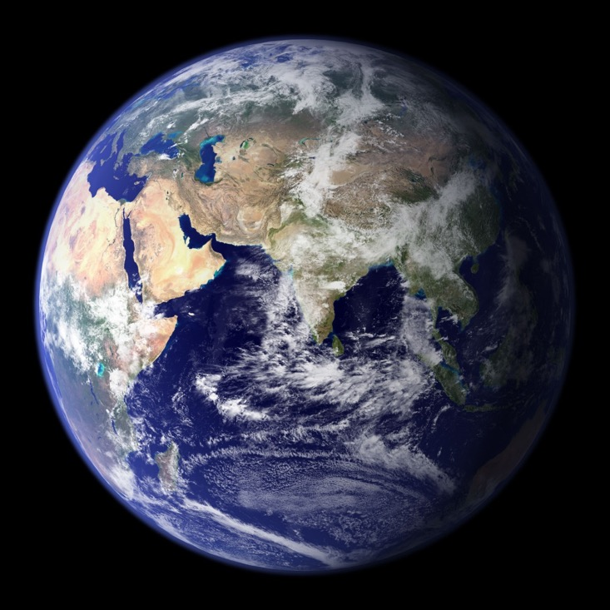
Module objectives:
To understand:
Why and how is the climate changing?
What does it mean for humanitarians?
What are the differences between a 1ºC world (now) and a 1.5ºC or 3ºC world (where we may be heading)?
Image: NASA
Notes:
Note:
a 1ºC world is what we live in now,
A 1.5-2ºC world which is the ambition of the Paris Agreement (Paris 2015) of the United Nations Framework Convention on Climate Change – UNFCCC
a 3ºC world is what we can expect based on the current commitments of world leaders (as expressed in 'Nationally Determined Commitments' to the United Nations Framework Convention on Climate Change – UNFCCC – in relation to the Paris Agreement and COP 21 in Paris 2015)

Slide 3
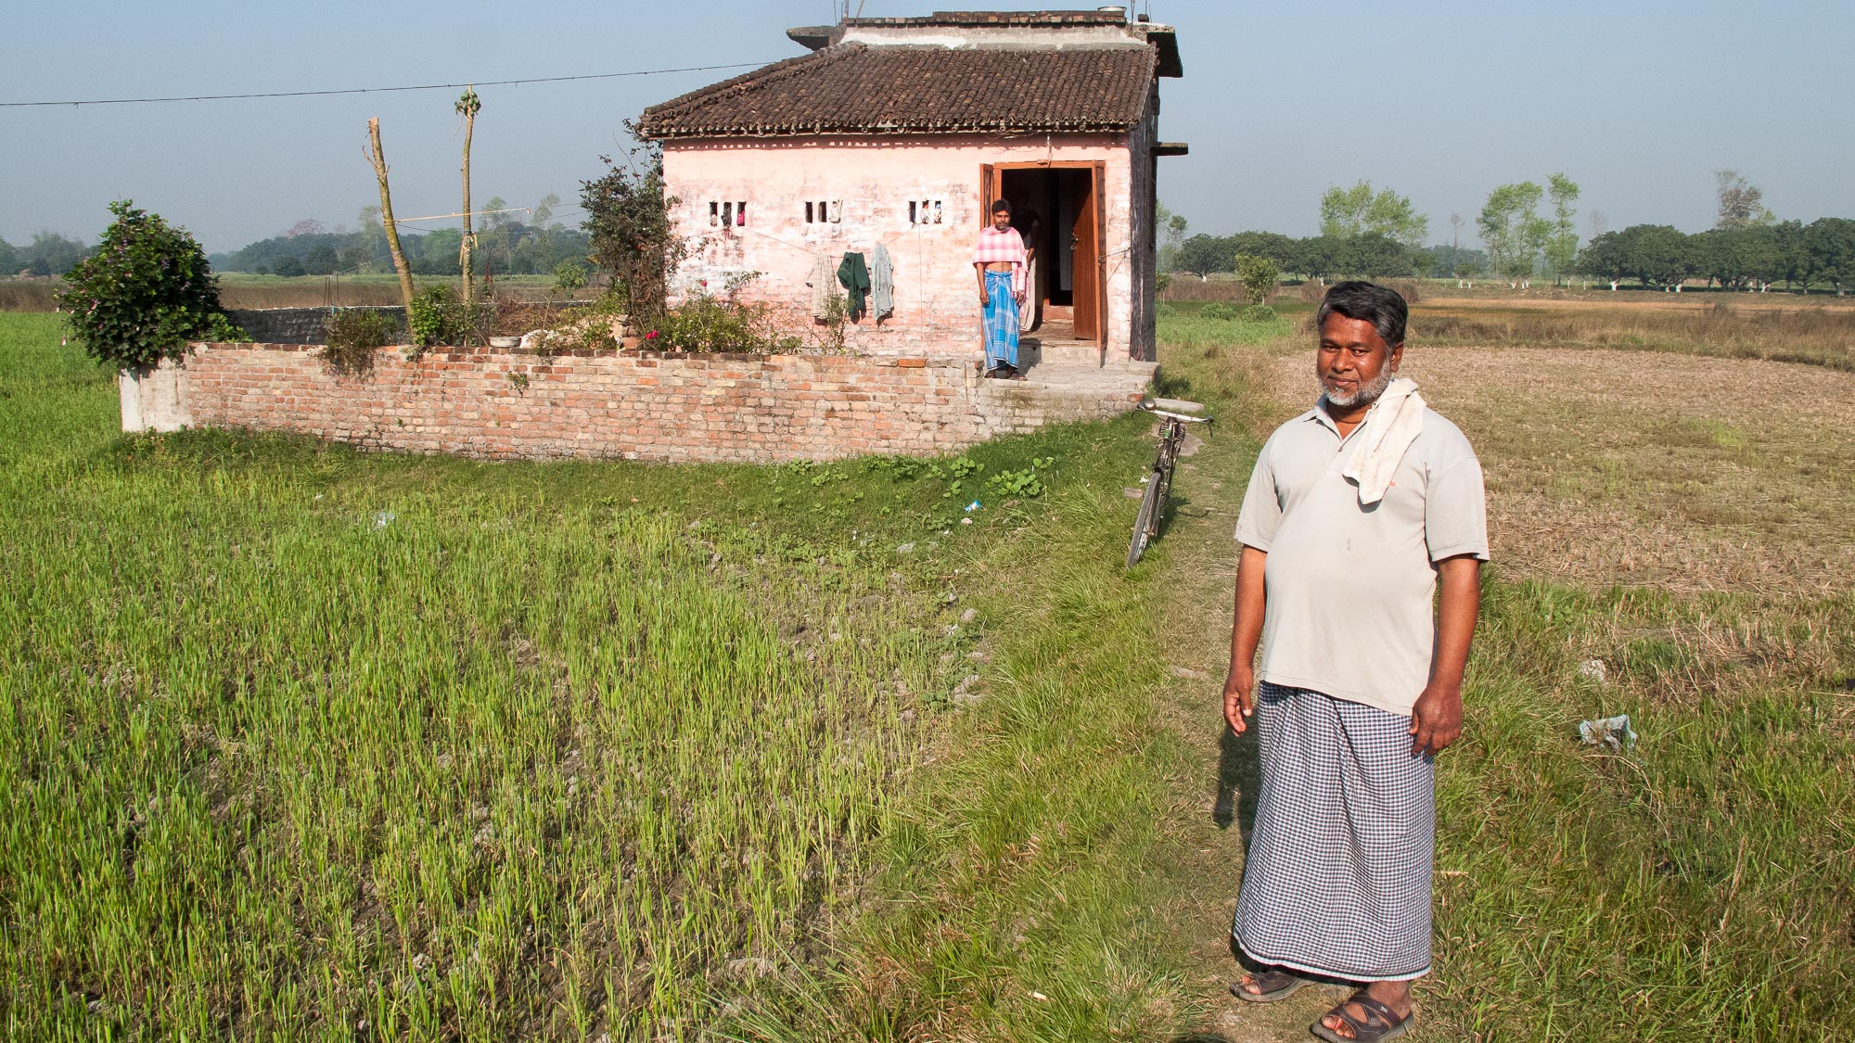
People report local
changes ….
”More and worse floods”
”Rains no longer normal – difficult to know when to plant”
”Our fields get eaten away by the sea”
”... so our children have to move away”
Notes:
People around the world already experience changing and unpredictable weather patterns affecting their living conditions. From Red Cross Red Crescent community programmes around the world testimonies of local impacts are indicating that changes are widespread and already significant – and also very different depending on the location.
This man in northern India, actually told exactly what the slide text says. Note that his last sentence indicates his long-term vision for how his family need to adjust to the gradual changes. He added, that since his chidren could not expect to inherit and contiunue to grow his rice fields, he invests in their schooling, to help them pursue other livelihoods.
Based on his observations, he is considering very long-term adaptation needs.
It will be important to get multiple voices like these, from different groups, especially marginalized groups. Hazards are experienced differently by various marginalized groups, as these groups are often disproportionately affected by extreme events. For instance, most of the casualties in the 2010 flooding event were women and girls, as they were not allowed to learn how to swim.

Slide 4
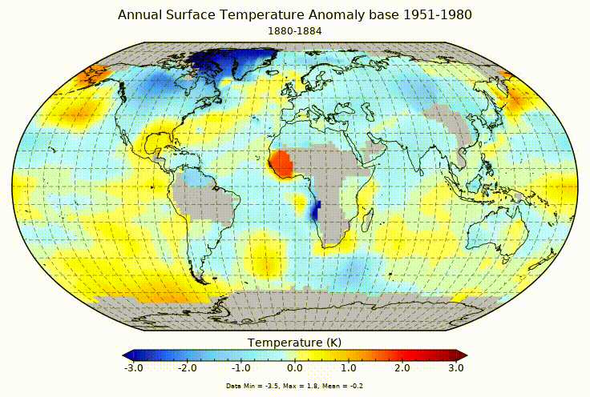
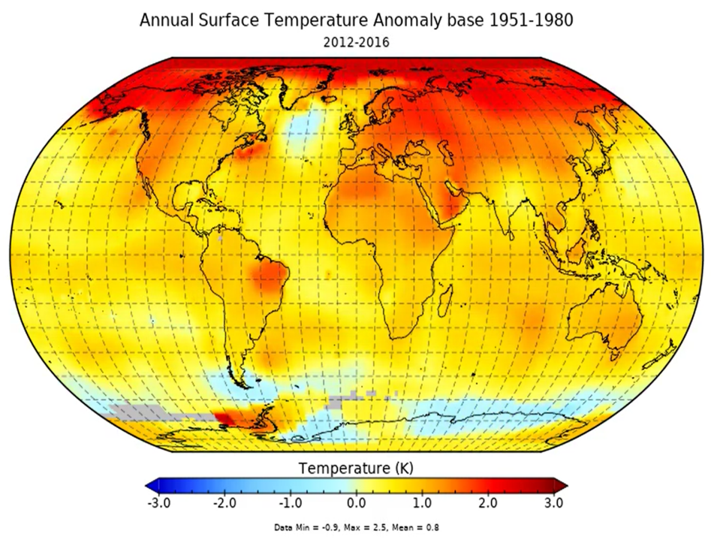
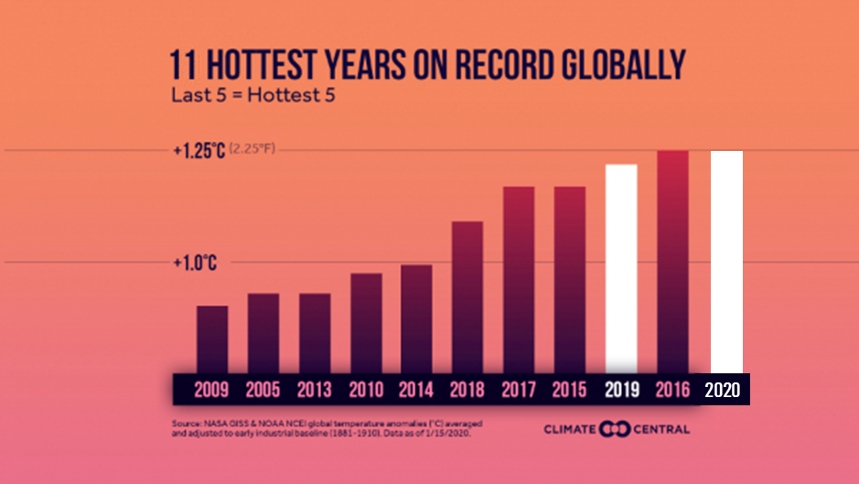
…and scientists’ data confirms that the problems are global
Source: NASA
Notes:
The average global temperature has been rising steadily over the past century.
The animation (from NASA) shows the 5-year mean temperature 1880-2017 – seen in relation to a "normal" period 1951-1980.
Note the very warm last decade at the end.
2016: 40th consecutive year global temperature was above average
More than 100 years since Earth has had a record cold year
2016: Record heat for land and oceans
Ten hottest years: Data from NOAA/National Center for Environmental Information. Graphic from Climate Central. Record cold year based on http://www.ncdc.noaa.gov/cag/time-series/global/globe/land_ocean/ytd/12/1880-2016... Subject to monthly reanalysis. Average here is the 20th century average defined by NOAA.

Slide 5
Science – what is it telling us?

Slide 6
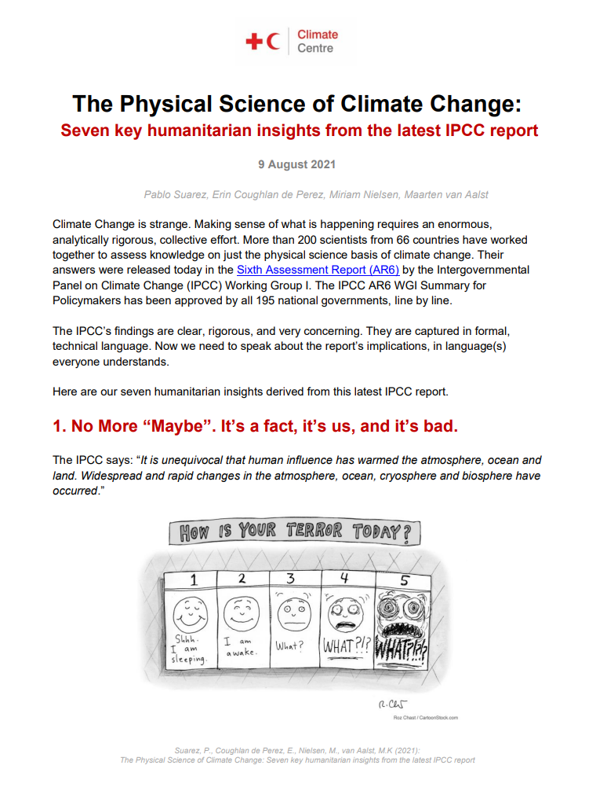
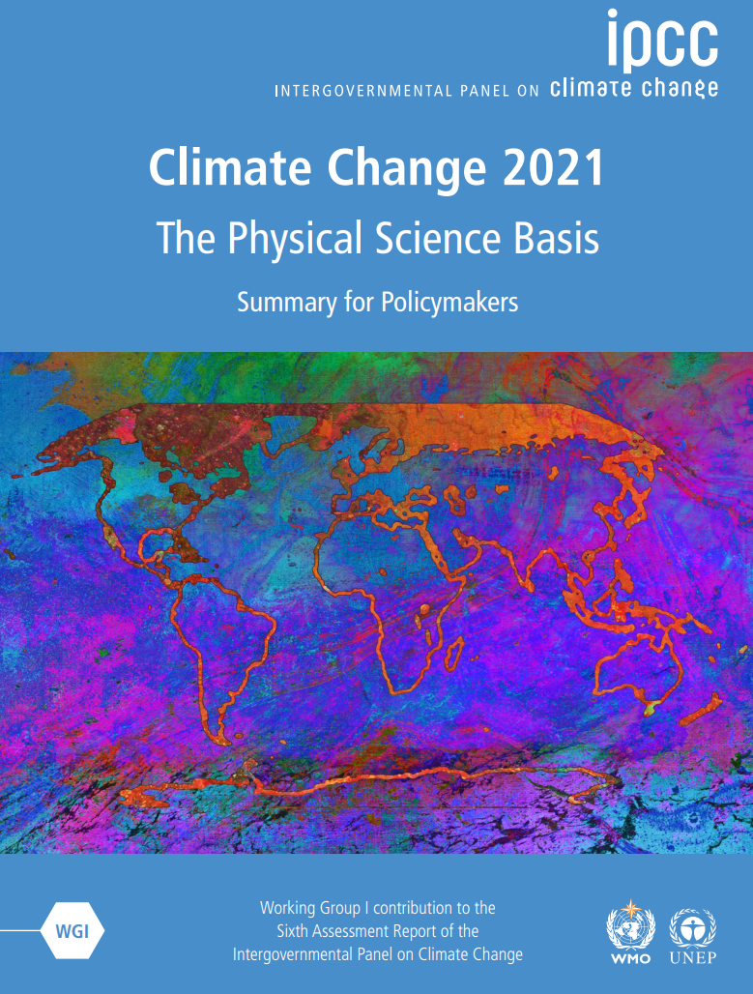
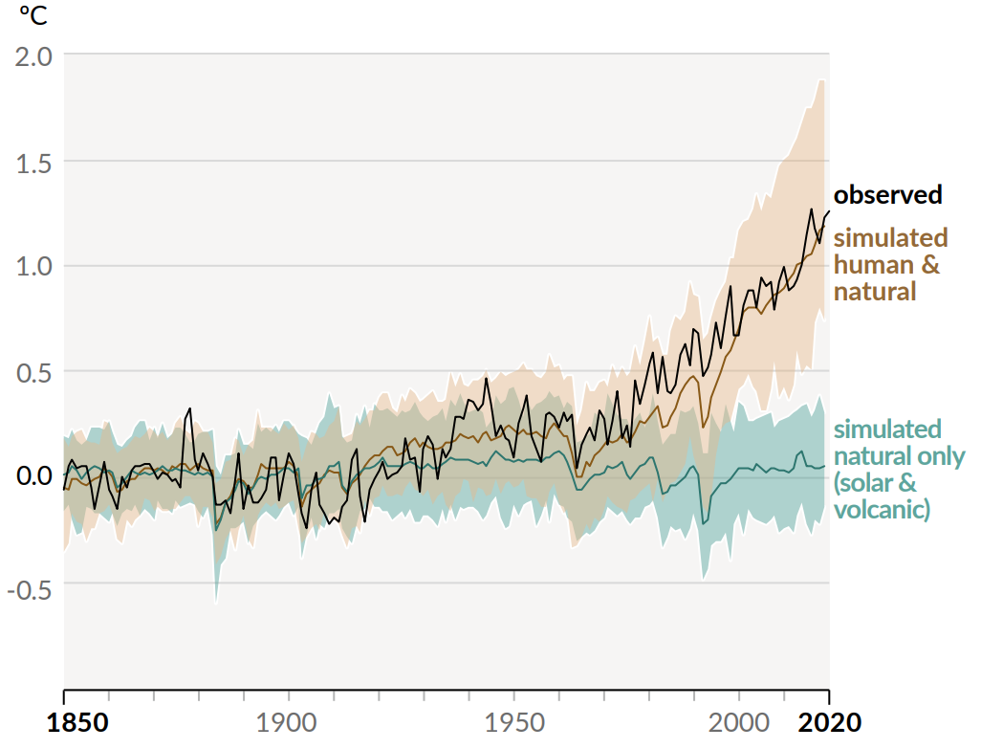
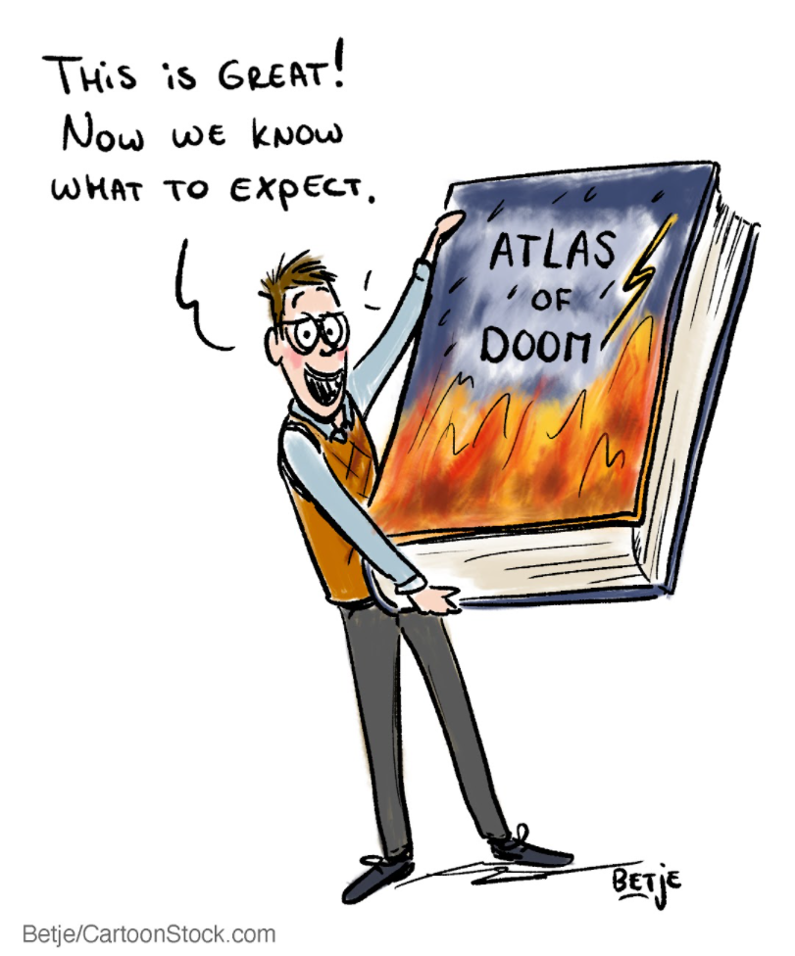
IPCC – the ‘key reference’on climate change (AR6 2021)
“It is unequivocal that human influence has warmed the atmosphere, ocean and land. Widespread and rapid changes in the atmosphere, ocean, cryosphere and biosphere have occurred"
"Human influence has warmed the climate at a rate that is unprecedented in at least the last 2000 years"
Notes:
The IPCC is the Intergovernmental Panel on Climate Change, the leading international body for the assessment of climate change, established by the United Nations Environment Programme and the World Meteorological Organization in 1988. Thousands of scientists worldwide contribute to it and their highly detailed reports are accompanied by a “Summary for Policymakers” (SPM), approved line-by-line at formal UN meetings and endorsed by all governments. The SPM then becomes the agreed scientific basis for international negotiations about climate change and is used for national policy-making on climate by many countries.
The latest report (2021) statements were clear and alarming:
“It is unequivocal that human influence has warmed the atmosphere, ocean and land. Widespread and rapid changes in the atmosphere, ocean, cryosphere and biosphere have occurred"
"Human influence has warmed the climate at a rate that is unprecedented in at least the last 2000 years"
it is bound to continue at an alarming rate unless substantial measures are taken to reduce greenhouse gas emissions and it already is and will continue to bring the world more extreme weather events.
One of the ways to identify that it is huma activity that causes the majority of the current rapid warming is to "model" climate with only the "natural" factors included – like solar radiation, tilting earth axis etc. - and see how it matches the observed/recorded temperature changes in the past, and compare to the modles when also human-caused greenhouse gas emissions are included: only with human factors included will the models fit the real world observations (see chart)
Many scientists consider a rise of 2 degrees C is a tipping point for disastrous and irreversible impacts, like the melting of the Arctic sea ice, Greenland ice sheet, and melting of permafrost (which would even trigger methane release, a potent greenhouse gas). Therefore, 2C is the upper goal of the Paris Agreement on Climate Change (2015).
The IPCC 6th Assessment Report (2021) was recently preceded by three Special Reports – one on 1.5ºC released 2018, one on climate change and oceans and the cryosphere expected Sept 2019, and one on climate change and land in Aug 2019 (desertification, land degradation, sustainable land management, food security, and greenhouse gas fluxes in terrestrial ecosystems), as well as a Methodology Report (guidelines for greenhouse gas inventories) in May 2019.
The 1.5˚C report highlighted:
Despite the global community’s best intentions to keep global warming below a 2°C increase above pre-industrial climate, higher levels of warming are increasingly likely.
Scientists agree that countries’ current United Nations Framework Convention on Climate Change emission pledges and commitments would most likely result in 3.5 to 4°C warming. And the longer those pledges remain unmet, the more likely a 4°C world becomes.
Find the short summary on Seven key humanitarian insights from the latest IPCC report at: https://www.climatecentre.org/wp-content/uploads/IPCC-AR6-WG1-SPM-Cartoon_infused-humanitarian-insights-.pdf
Facilitator tip: consider running the 2:30 minute movie clip: “World Could Be 4 Degrees Hotter By End of This Century” available at http://www.youtube.com/watch?v=CQbOlI0YQNs

Slide 7
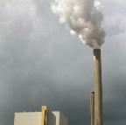
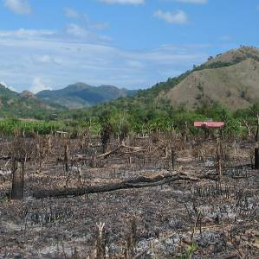
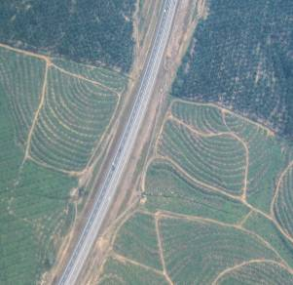
Why is it getting warmer?
Answer: The rapid global warming of the past 100 years is caused mostly by human activity, mainly:
Burning fossil fuels (e.g. coal, oil, natural gas), sending “greenhouse gases” (GHG) into the atmosphere
Widespread deforestation (trees absorb and contain a lot of carbon, and when burnt CO₂ is released)
Changing agricultural and land-use practices (agriculture releases other GHGs, CH₄ and NO₂)
Notes:
Historical records show that our climate has always varied naturally over time, for instance due to changes in the intensity of the Sun’s energy reaching the earth, volcanic eruptions, and natural changes in greenhouse gas (GHG) concentrations.
However, the rapid warming in recent decades cannot be attributed only to such natural variation. Scientific consensus now tells us that human activities are 'very likely' to blame (>95% certainty, IPCC 2013).
CO2 is the most important GHG - some other greenhouse gases are methane, nitrous oxide, water vapor.
All photos: Climate Centre

Slide 8
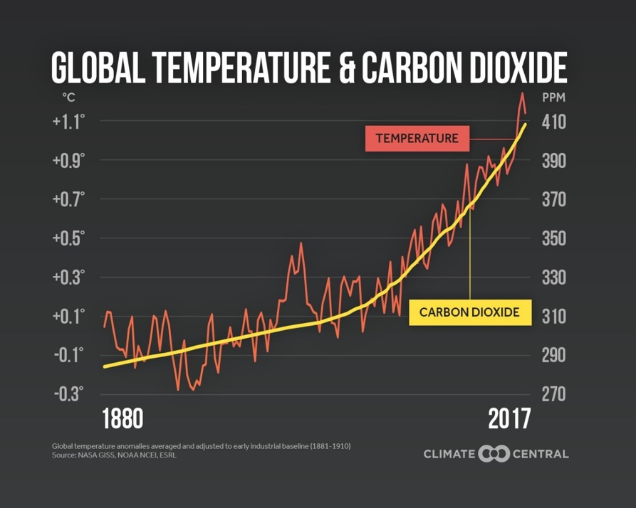
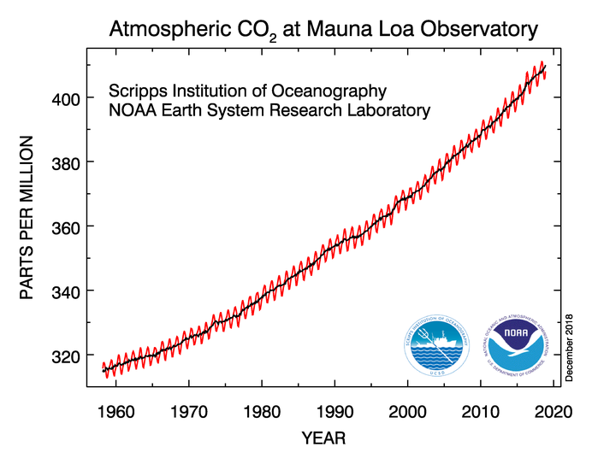
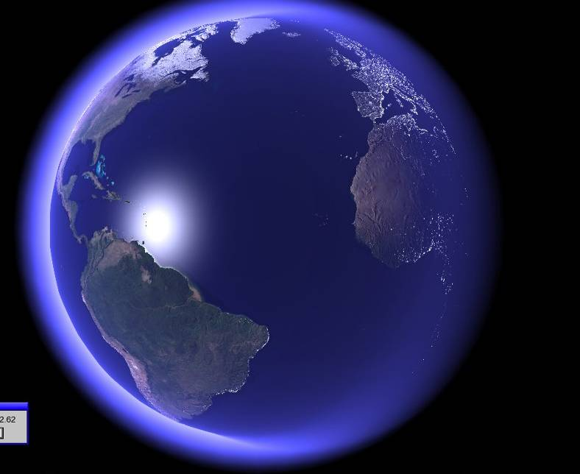
Why is it getting warmer?
Greenhouse gases are acting as a blanket around the earth
Notes:
Short answer: Greenhouse gases act as a blanket over the earth, keeping it warmer. Human activities (as mentioned on the previous page) are adding greenhouse gases to the atmosphere, making it warmer and warmer.
Technical explanation
The greenhouse effect is actually part of a natural process: the sun warms up the earth, the earth radiates the heat back into the atmosphere through thermal radiation. This heat is absorbed by greenhouse gases in the atmosphere, and is re-radiated in all directions. This “blanket” of greenhouse gases that prevents the heat from escaping right away causes the temperature to be higher than what it would be without greenhouse gases in our atmosphere (which is a good think, because without our atmosphere it would be very cold on earth).
However, the human activities mentioned on the previous slide are now rapidly adding additional greenhouse gases to the atmosphere, as can be seen on this graph with the annual variation (red) concentration of CO2 in the atmosphere measured at one station in Hawaii. In 2013 the concentration for the first time in at least 800 000 years exceeded the 400 parts per million mark on the graph (not shown) – by December 2018 it was 408 ppm.
This rapid rise in greenhouse gases is resulting in a rising global temperature: climate change.
Further background information
In 2013 IPCC concluded that:
“Human influence on the climate system is clear. It is extremely likely (>95%) that human influence has been the dominant cause of the observed warming since the mid-20th century”
“The atmospheric concentrations of.. [greenhouse gases] .. have increased to levels unprecedented in at least the last 800,000 years. CO2 concentrations have increased by 40% since pre-industrial times, primarily from fossil fuel emissions and secondarily from net land use change emissions.”
“Continued emissions of greenhouse gases will cause further warming and changes in … the climate system”

Slide 9
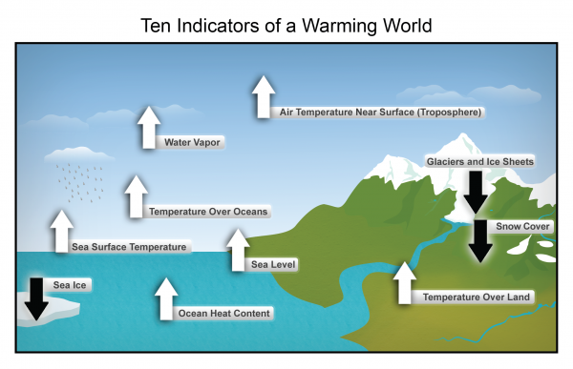
Source: NOAA NCDC
Notes:
Summary of the main indicators of a warming world:
Seven of the 10 indicators are expected to increase in a warming world and to decrease (Sea ice, Snow cover, Glaciers).
Scientific observations now show that all indicators are already evolving as can be expected in a changing climate.
(See also: NOAA, Ten Signs of a Warming World, https://cpo.noaa.gov/warmingworld/index.html).
https://www.globalchange.gov/browse/reports/climate-change-impacts-united-states-third-national-climate-assessment-0

Slide 10
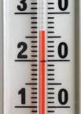

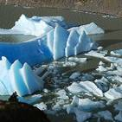
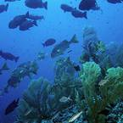
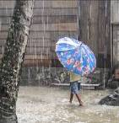
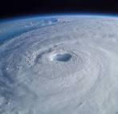
The earth is getting warmer – what does it mean?
Rising temperatures, heat waves
Sea level rise
Scientists very sure
Melting ice
Ocean acidification
Changing rainfall patterns
Less clear,
and regional differences
Changes in extreme events
Notes:
Walk through an overview of the expected changes, using the points below. Explain that the rest of the presentation will cover impacts on human society in more detail.
It is a fact that Greenhouse Gas concentrations is increasing, but the effects following from that have different levels of “certainty”:
1) Rising temperatures – with heat waves:
We know that at the “global scale” (i.e. for most land areas with sufficient data)
It is very likely that there has been an overall DECREASE in the number of cold days and nights.
It is very likely that there’s been an overall INCREASE in the number of warm days and nights.
In the future, for most land areas, this trend is expected to continue.
Sea surface temperatures are also rising; “minimum” temperature extremes have risen.
Heat waves are expected to become more frequent and more intense.
Source: http://www.climatechange2013.org/images/uploads/WGIAR5_WGI-12Doc2b_FinalDraft_Chapter02.pdf
2) Sea level rise
-Ocean thermal expansion and glacier melting have been the dominant contributors to 20th century global mean sea level rise.
-Thermal expansion: ocean temperatures have been increasing, water expands as it warms → sea level rise
-Glacier melting: land based ice that melts and flows into the ocean, increasing mass of water in the ocean → sea level rise.
-Higher sea levels put coastal cities at risk from flooding, more intense storm surges, and coastal erosion.
-Higher sea levels also increase risks for salt-water contamination of farmland and freshwater sources.
Source: http://www.climatechange2013.org/images/uploads/WGIAR5_WGI-12Doc2b_FinalDraft_Chapter13.pdf; http://www.ipcc.ch/publications_and_data/ar4/wg1/en/faq-5-1.html
3) Melting ice (sea ice and glaciers)
Sea ice = frozen sea water that floats on the ocean’s surface
Glaciers = dense, year-round ice on land, examples: Greenland and Antarctic ice sheets, and mountain glaciers in Asia, Europe and the Americas
- Rising temperatures have caused glaciers and sea ice (especially around the North Pole) to melt faster than many scientific projections
- Melting ice has implications for sea level rise and ocean chemistry.
Source: http://www.climatechange2013.org/images/uploads/WGIAR5_WGI-12Doc2b_FinalDraft_Chapter13.pdf
4) Ocean acidification – and its effects
-The ocean has absorbed more CO2 as emissions have risen, this increases the pH of the water and has serious implications for marine life, e.g. when the sea turns more acidic (with CO2) the calcium 'skeletons' of many lifeforms cannot be formed (or are weakened). Biodiversity is under pressure due to increasingly inhospitable environmental conditions (e.g., coral bleaching because of acidifying oceans).
Source: http://www.climatechange2013.org/images/uploads/WGIAR5_WGI-12Doc2b_FinalDraft_Chapter03.pdf
5) Changing rainfall patterns
Data limitations make it difficult to say with certainty what the rainfall trends will be in all regions of the globe, BUT:
on average, places that have currently have heavy precipitation can expect to see the intensity of rainfall events increase, places that are dry can expect less frequent rainfall (but more intense rain when it falls). And even in areas that on average may expect decreasing total rainfall, the rains may fall in shorter, intense bursts.
Or in other words: “The wet get wetter and the dry get drier”; this means drought and flash floods becomes more frequent in many places around the world.
Sources: http://www.gfdl.noaa.gov/cms-filesystem-action/user_files/kd/pdf/gfdlhighlight_vol1n5.pdf; http://www.ipcc.ch/news_and_events/docs/ar5/ar5_wg1_headlines.pdf
6) Changes in extreme events
-Heat waves and droughts have become more frequent, and in some places, more intense.
-It is difficult to measure the frequency and intensity of floods, but generally there has been an increasing trend.
-Climate change is expected in increase the frequency of high-intensity tropical storms.
-Very difficult to identify trends with tornados, dust storms, hail, and other severe local events because data reliability is low and current climate models don’t simulate these phenomenon. BUT, risks are expected to increase with demographic and land use changes increase people’s exposure to these events.
Sources: (http://ipcc-wg2.gov/SREX/images/uploads/SREX-SPMbrochure_FINAL.pdf) (http://www.nature.com/nclimate/journal/v2/n3/full/nclimate1357.html) (http://www.ipcc.ch/publications_and_data/ar4/wg1/en/ch3s3-8-4-2.html) (http://www.ipcc.ch/pdf/special-reports/srex/SREX_Full_Report.pdf)
(explain that this presentation will go through these points in more detail)
“Melting ice” picture: http://www.flickr.com/photos/worldresourcesinstitute/3525024219/ ; Photo by Linda Shaffer, World Resources Institute, 2009.
“Ocean acidification” picture (bleached coral): http://www.flickr.com/photos/worldresourcesinstitute/5476510553/ ; Photo by Mark Spalding, World Resources Institute, 2011.
"Extreme events" picture: NOAA
Remaining pictures: Climate Centre
10

Slide 11
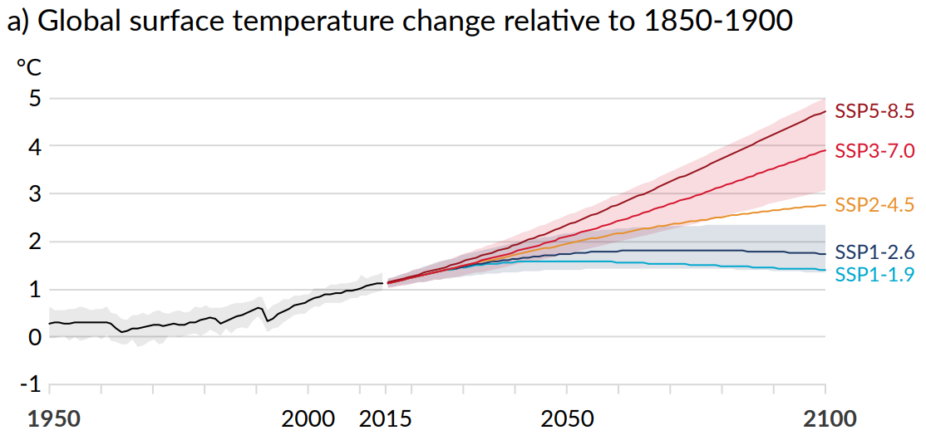
Warming will continue, but how much is our choice…
Temperatures will continue to rise for decades, even if we stop emissions of GHGs (blue lines)
But if we cut the global GHG emissions quickly, we may avoid escalating warming in the second half of this century (the red lines)
NOW
Source: IPCC AR6 (2021)
Notes:
Upper graph:
As you can see from the chart, both the best case (Light blue line) and worst case (Dark red line) scenarios show temperature increases.
Temperatures are bound to rise even if we stop emissions immediately
Climate change may still continue for centuries due to the time scales associated with climate processes and feedbacks.
This means we are bound to at least 20 more years of temperature increase (and other climate change impacts); so, we have to prepare!
If we act now to reduce global emissions, it is still possible to keep changes within a “manageable range” for our children

Slide 12
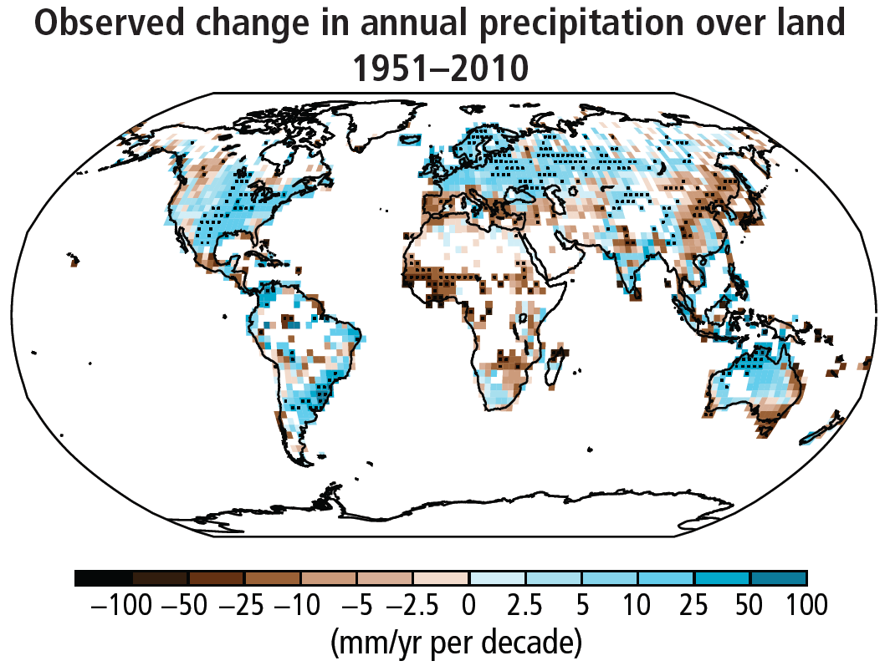
Rainfall is already changing…
Source: IPCC
Notes:
Observed change in annual rain/snowfall the past 60 years:
in some areas LESS rain: 100 mm/year per decade
In others MORE rain
BUT - DO NOT try to look at the maps for specific changes for your region, its much more complex to interpret
Source: IPCC AR5

Slide 13
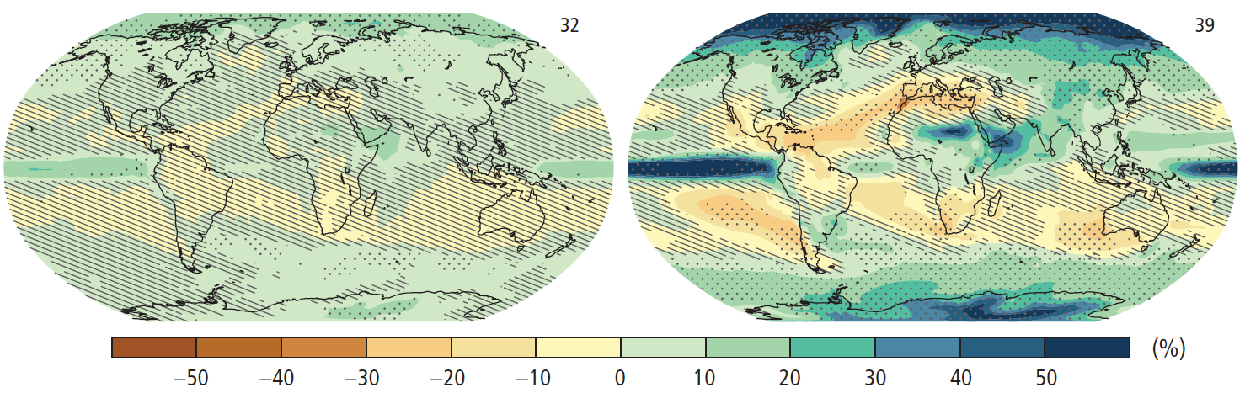
Rainfall continues to change…
Expected future change in rainfall this century compared to the period 1986-2005
Low scenario – if humans cause
less climate change
High scenario – if humans continue
to cause more climate change
Source: IPCC
…but high uncertainty in many regions
Notes:
The map from IPCC 2013 shows expected changes in rainfall compared to now (=1986-2005):
In the map to the left is the low scenario case (= if we stop for further CO2 emissions into the atmosphere)
In the map to the right is the high scenario (= if we continue very high greenhouse gas emissions)
Stippled (=dotted) areas are where the projections are best = most certain; areas with cross-hatching (slanting lines) are areas where the projected changes are small relative to natural internal varibability. Note that uncertainties are high for many important regions!
Note: “Precipitation” = rain + snow

Slide 14
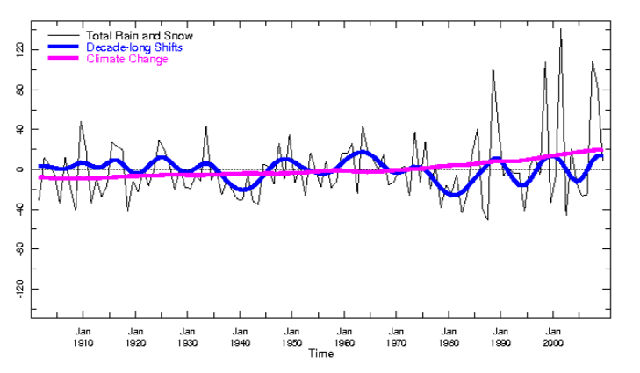
More extreme events – the 'textbook example'
New record highs
Long term average
Historically manageable variation
Adaptation needs
Source: IRI/IFRC Maproom
Notes:
This graph illustrates the case – although it is annual rainfall data, not single rainfall events:
The extremes get more extreme and frequent, so there are more surprises.
This is what people experience, even though the long term average does not show drastic changes (purple line).
In other words – many parts of the world may see more extreme rainfall events.
Bigger highs and bigger lows.
Note also that the blue 10-year running mean varies quite a bit, so people may experience and report (for instance in community assessments) that the climate is changing, although they may only perceive and remember the recent decade or so. This is a good reason always to compare local information with scientific data.
So again in brief: the most immediate effect of climate change in relation to humanitarian work is not the gradual shift in temperature or rainfall, but that we encounter new records highs (and lows) that exceeds our experience and expectations – so there are “more surprises”.
This graph shows annual rainfall in Sri Lanka in the monsoon months (generated from IFRC-IRI Map Room): http://iridl.ldeo.columbia.edu/maproom/IFRC/FIC/

Slide 15
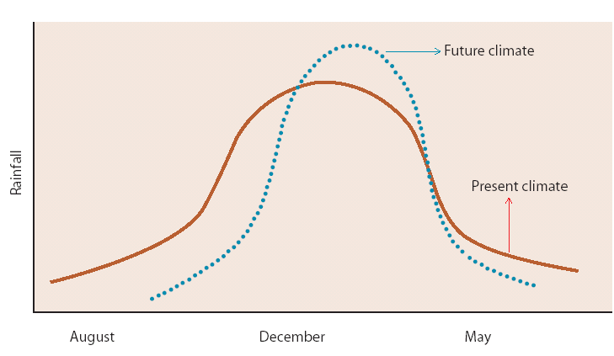
Shifts in seasonality and amount
Example Indonesia - compared to 1961-90:
Onset of the wet season is 10 - 20 days later
Onset of the dry season is 10 - 60 days earlier
Most of the rainfall now falls in January, when it used to fall in December
When it rains it pours
Based on Naylor et al. 2007
Notes:
15
15
An example form Indonesia on shifting seasonal rainfall patterns
Changes in rainy season – start and duration, and with more intense rain events – may be a bigger challenge to farmers, and for general flood risks, than the changes in the average amount of rains season
Start and stop dates are different to the past – hard to plan and make decisions, also seeing changes in the total amount of rainfall and dryness – distribution of rainfall across the season.
Figure based on (not copied from) Naylor et al (2007): https://www.pnas.org/content/104/19/7752
An example from Indonesia shows how climate change may alter the seasonality of rainfall patterns (and agricultural seasons with it): rainy season starts later and become shorter, but with more intense precipitation (see chart).

Slide 16
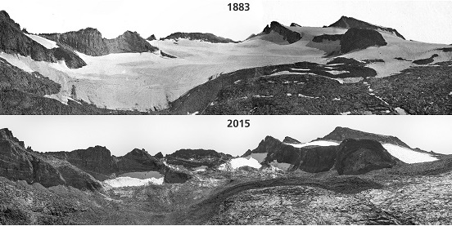
1883 Photo: USGS Photo/Israel Russell 2015 Photo: NPS Photo/Keenan Takahashi
Notes:
Photo pairs show the retreat of the Lyell Glacier (Yosemite National Park) from 1883 to 2015. Park scientists throughout the National Park Service study glaciers to understand the effects of climate change in their parks.1883 Photo: USGS Photo/Israel Russell 2015 Photo: NPS Photo/Keenan Takahashi

Slide 17
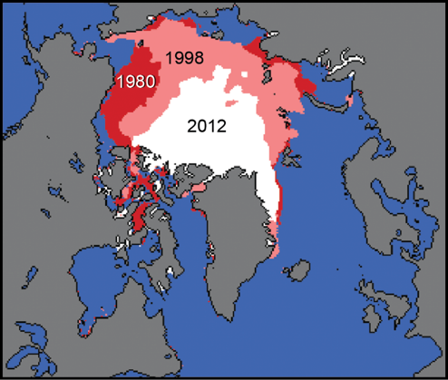
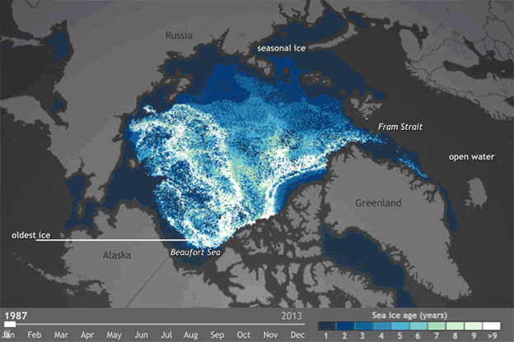
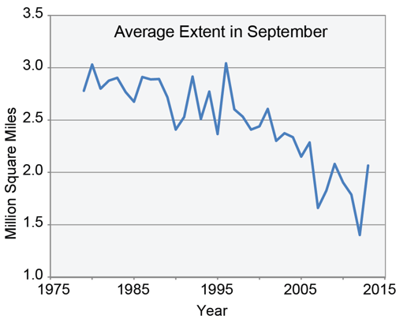
Much reduced sea ice in the Arctic ocean
Source: GlobaleChange.gov
Source: NOAAClimate
Notes:
Sea ice in Arctic Ocean rapidly dimishing.
On the animation, note how especially the later years show a rapid decline.
Sources: https://nca2014.globalchange.gov/report/our-changing-climate/melting-ice
Animatoin: NOAA - https://www.youtube.com/watch?v=Fw7GfNR5PLA

Slide 18
Impacts – what does it mean for the humanitarian sector?

Slide 19
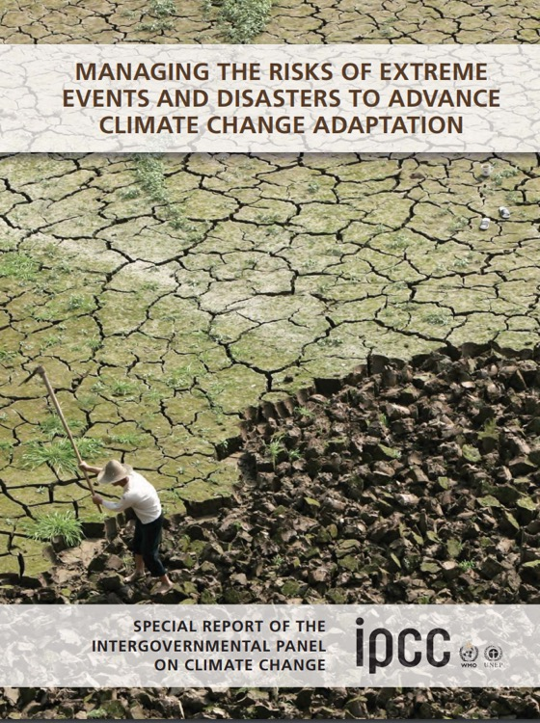
Climate change = changes in disaster patterns and risks
“A changing climate leads to changes in the frequency, intensity, spatial extent, duration, and timing of extreme weather and climate events, and can result in unprecedented extreme weather and climate events.”
(IPCC, SREX, 2012)
Notes:
The increase in disaster and future risks is analysed in the 2012 IPCC report ”Managing the risks of extreme events and disasters to advance the climate change adaptation” which noted that the rise in disasters has several reasons, including
polulation changes,
urbanisation environmental changes
as well as changes in the climate
So scaling up risk reduction efforts are needed to counter the trend.
19

Slide 20
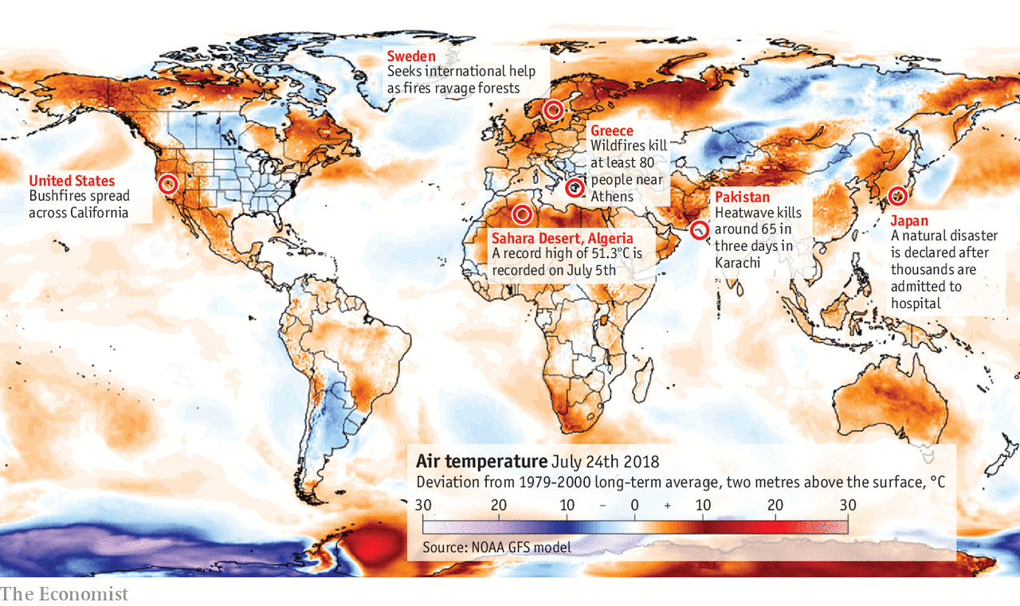
Rising temperatures – more heat waves
Notes:
Climate change increases the risk of temperature extremes for most places.
We can expect an increase of the number of hot days and nights and more heat waves world wide. Heat waves are a large risk, causing a higher death rates amongst the elderly and the chronically ill. Especially if the nights are not cooling off during heat waves the human body can not cool itself enough, which can result in heat stress/ heat stroke or dehydration. We have already experienced an increase in the frequency and intensity of heat waves.
Figure in slide: Temperature deviation on 24 July 2018 compared to long-term average 1979-2000; (source: NOAA GFS model – notes by The Economist)
Recent examples can indicate the increase of vulnerability to heat: especially, the 2003 heat wave in West Europe with a death toll of almost 72,500 people and in Russia in 2010 almost 56,000 people died (Source: EM-DAT data).

Slide 21
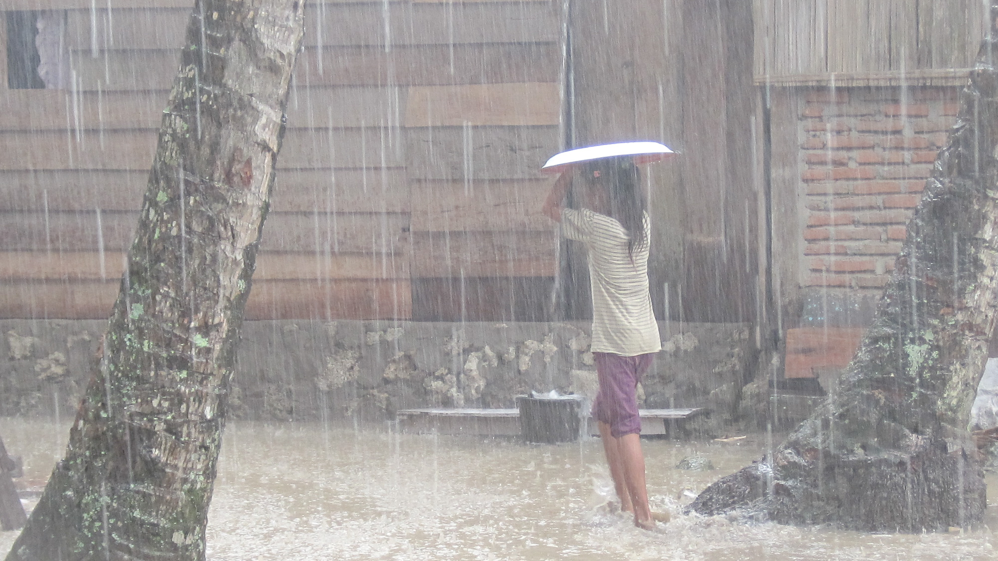
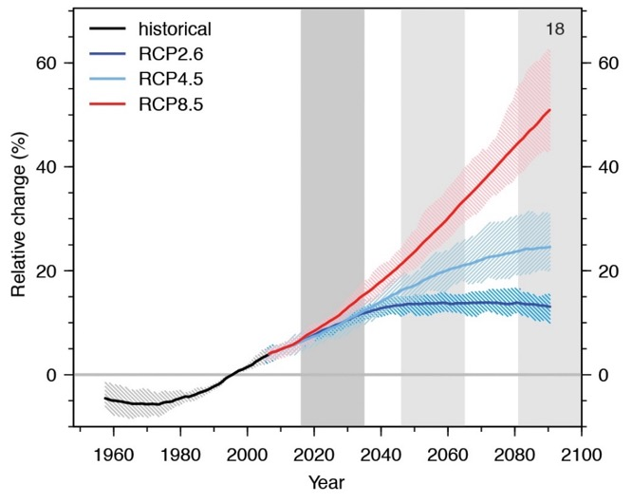
Changing rainfall patterns – floods and drought
Rainfall seasons around the world may shift → major implications for global agriculture
Amount of rainfall in each region might change
Number of extremely rainy events might increase in many places → changes in floods and water flows
Other places could see an increased number/duration of dry spells → water stress for vulnerable populations
Rainfall on very wet days
NOW
Notes:
The graph is from IPCC 2013 – showing change in rainfall on very wet days in the past and in the future if we stop GHG emissions now (dark blue line), continue emitting large amounts og GHG (red line), and intermediate (controlled GHG emissions)
Background information – from IPCC 2013:
The high latitudes and the equatorial Pacific Ocean are likely to experience an increase in annual mean precipitation by the end of this century (if high GHJG emissions continue)
In many mid latitude and subtropical dry regions, mean precipitation will likely decrease, while in many midlatitude wet regions, mean precipitation will likely increase by the end of this century
• Extreme precipitation events over most of the mid-latitude land masses and over wet tropical regions will very likely become more intense and more frequent by the end of this century
• Globally, it is likely that the area encompassed by monsoon systems will increase over the 21st century. ... monsoon precipitation is likely to intensify
Photo: Climate Centre

Slide 22
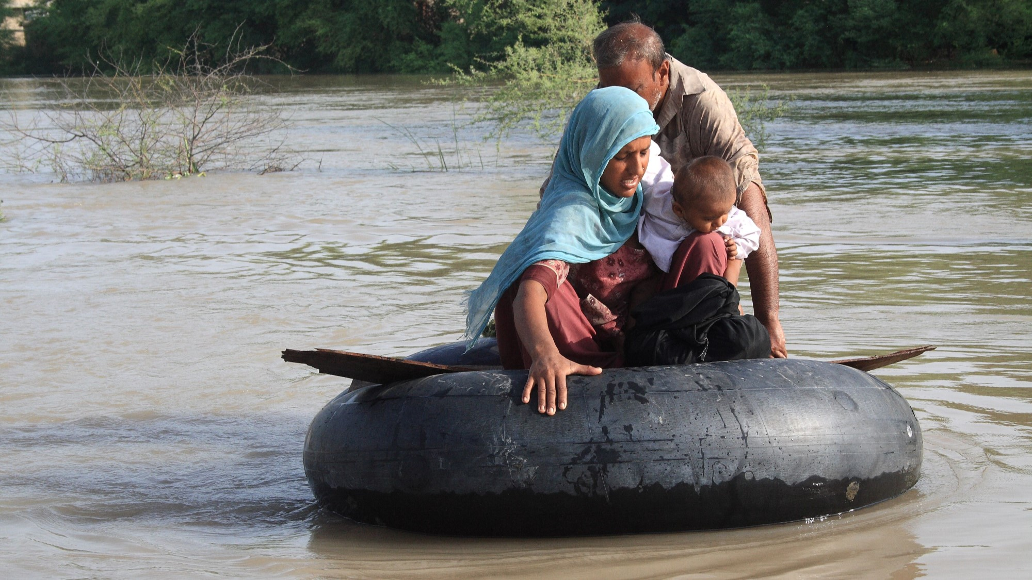
Floods
Difficult to measure the frequency and intensity of floods, but there have been noticeable shifts in some areas
Changes in rainfall patterns and intensity could put more people at risk from flooding
Photo: Alex Wynter/IFRC
Notes:
It is difficult to measure the frequency and intensity of floods, but generally there has been an increasing trend.
Floods depend on a number of different factors (land use, water management, flood policies, etc.) so measurement can be difficult.
Climate is never the only factor that can increase risk of flooding. Floods can of course also be strongly affected by other factors, such as rapid and unplanned urbanization, population growth and poor natural resource management.
BUT, changes in rainfall patterns and precipitation intensity could put more people at risk from flooding.
http://www.ipcc.ch/pdf/special-reports/srex/SREX_Full_Report.pdf
Photo: Alex Wynter/IFRC

Slide 23
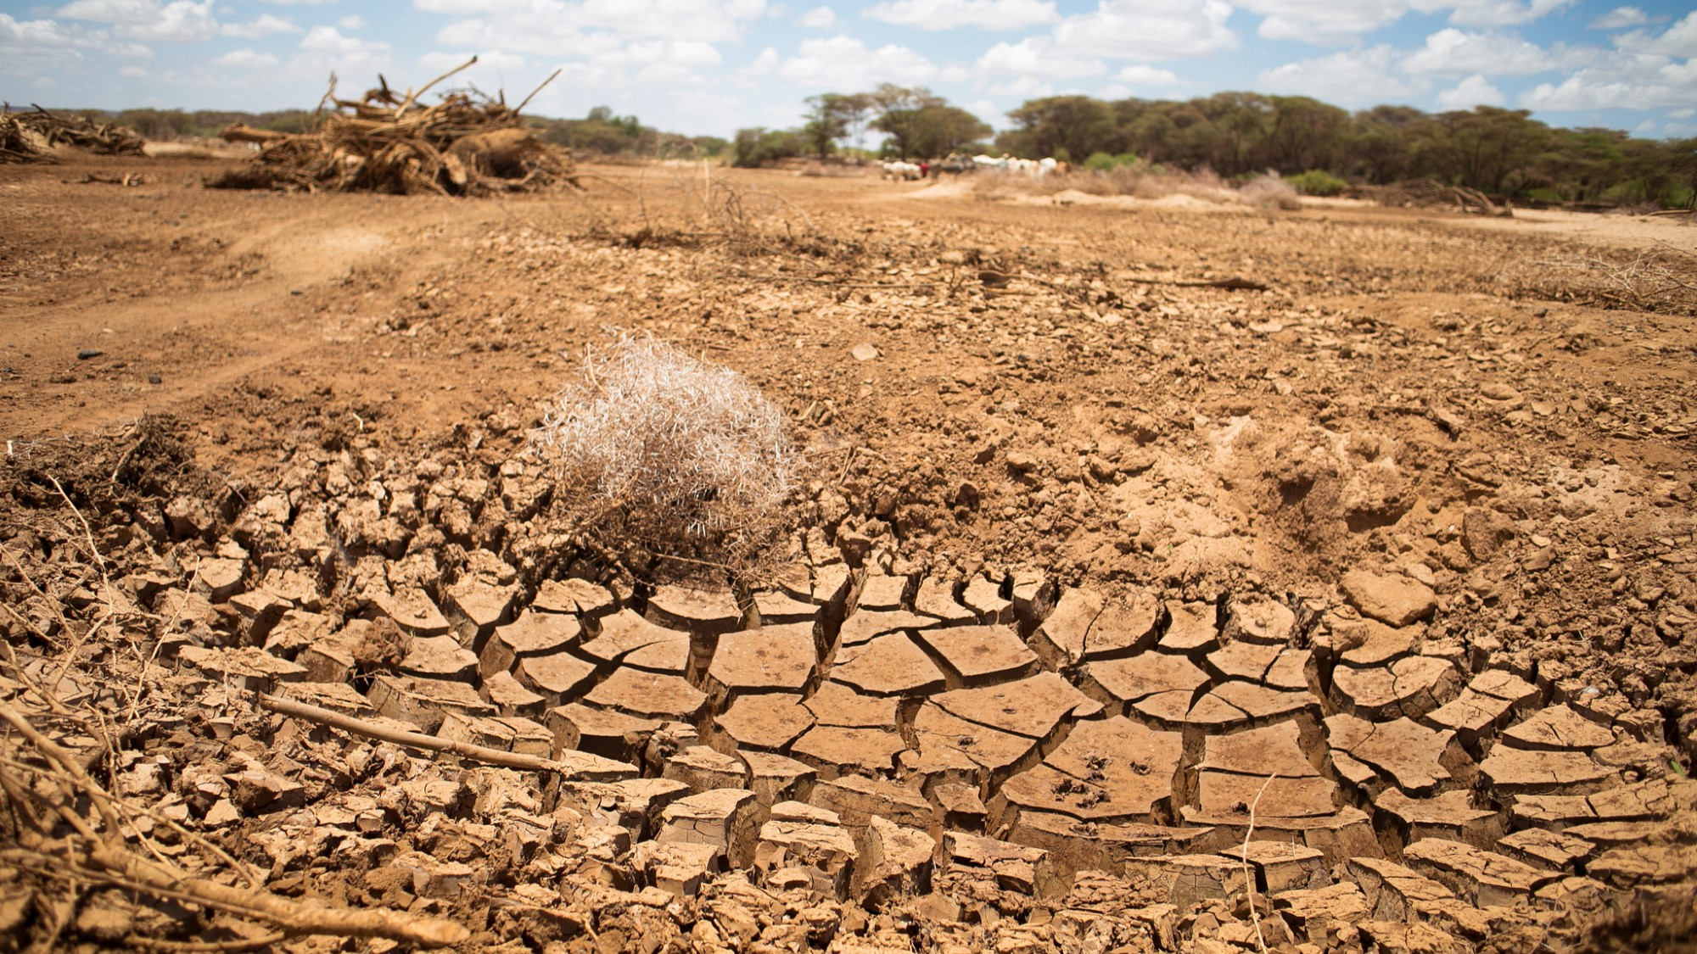
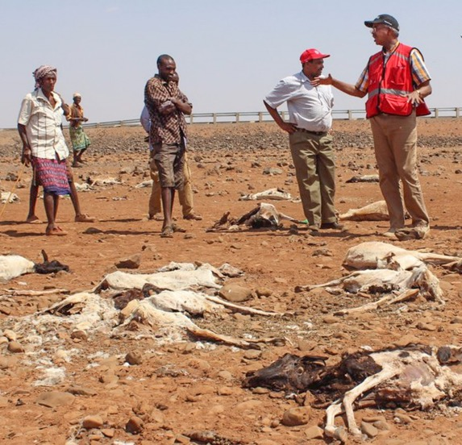
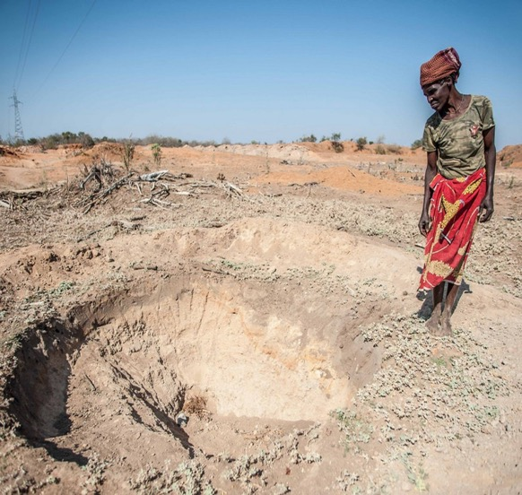
Drought
Some regions of the world have experienced more intense and longer droughts (IPCC, medium confidence)
Droughts will intensify in the 21st century in some seasons and areas (IPCC, medium confidence)
Photos: IFRC
Notes:
Drought frequency and duration has increased, this trend is generally expected to continue (with the exception of some of the far northern and far southern latitudes, where droughts may decrease).
Droughts have important implications for for global food production.
Statements from IPCC SREX Report:
"There is medium confidence that some regions of the world have experienced more intense and longer droughts, in particular in southern Europe and West Africa, but in some regions droughts have become less frequent, less intense, or shorter, for example, in central North America and northwestern Australia.
"There is medium confidence that droughts will intensify in the 21st century in some seasons and areas, due to reduced precipitation and/or increased evapotranspiration. This applies to regions including southern Europe and the Mediterranean region, central Europe, central North America, Central America and Mexico, northeast Brazil, and southern Africa"
SREX Report (IPCC 2012): https://public.wmo.int/en/media/news/ipcc-launches-special-report-extreme-weather-events

Slide 24
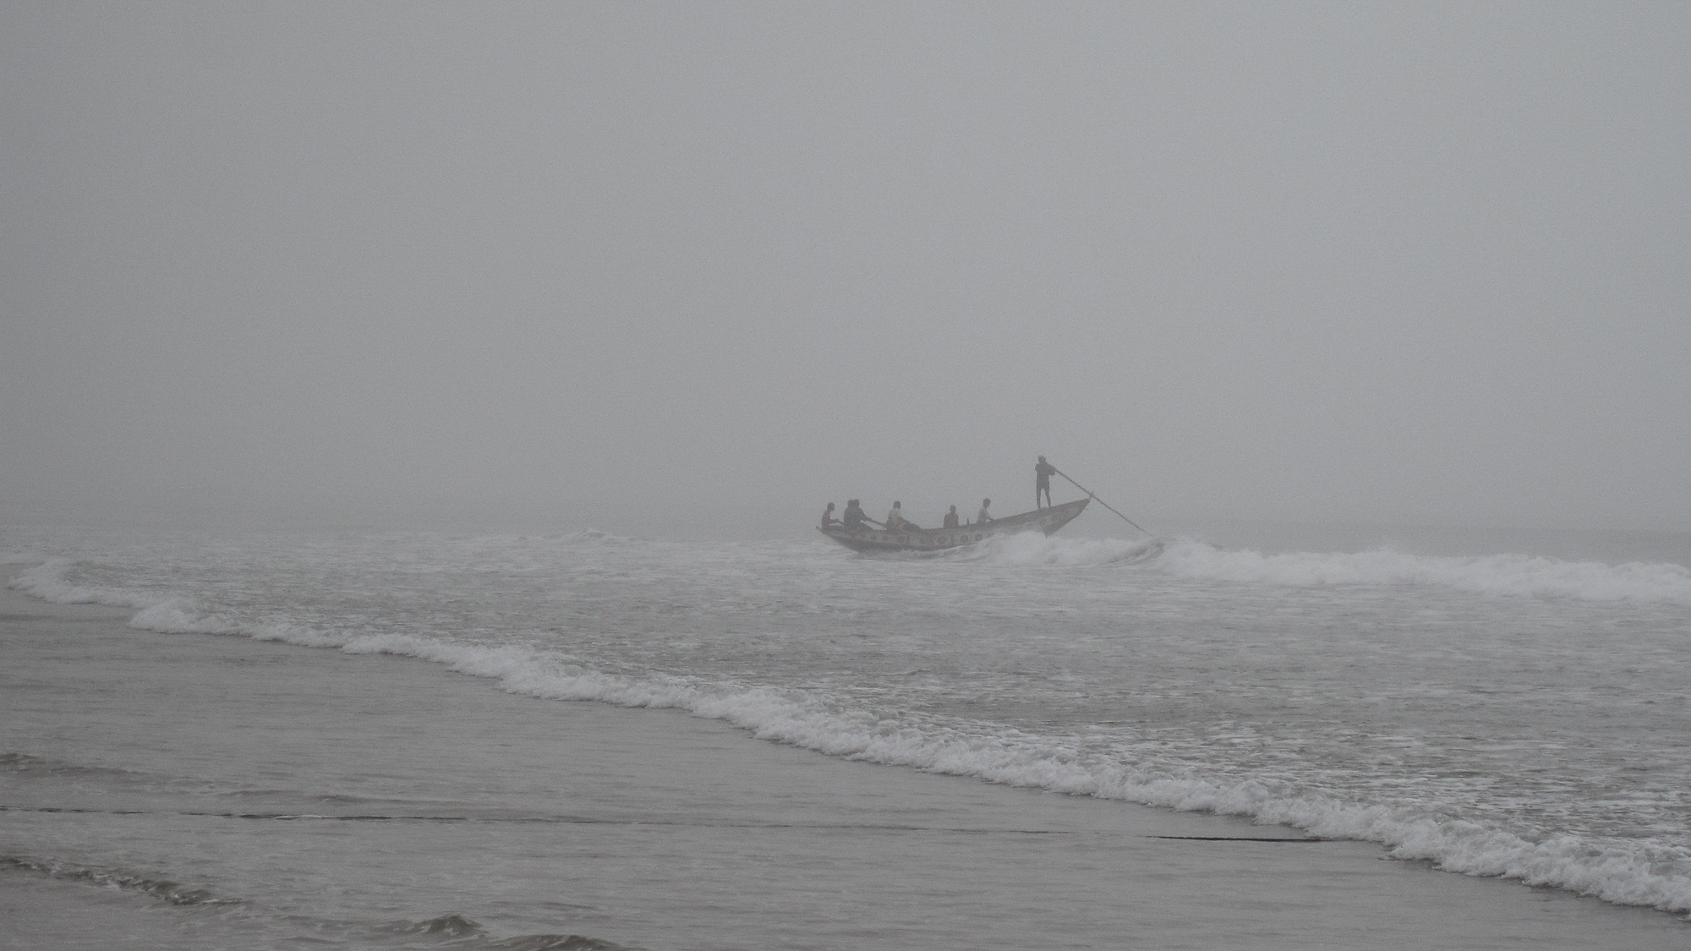
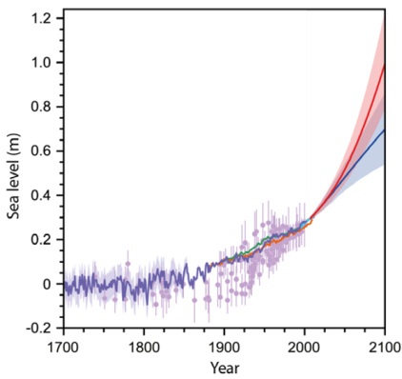
Sea levels are rising more quickly than any time in the last 2000 years
Sea levels are rising – at an increasing rate (currently about 3.4 mm/year)
Sea level rise
NOW
Photo: Climate Centre
Notes:
Sea levels are rising due to two factors:
as the ocean gets warmer, the water expands, and
ice on land melts (i.e. the glaciers, including the ice caps in Greenland and Antarctica, melts and water flows into the ocean)
The graph is from IPCC 2013 – showing showing historical records of sea levels, and projected sea level rise for the future if we
stop GHG emissions now (dark blue line),
or continue emitting large amounts og GHG (red line)
Global average sea level rise is now 3.4 mm/year; in the 1990'ies it was 2.5 mm/year (Source: NASA: https://climate.nasa.gov/news/2680/new-study-finds-sea-level-rise-accelerating/)

Slide 25
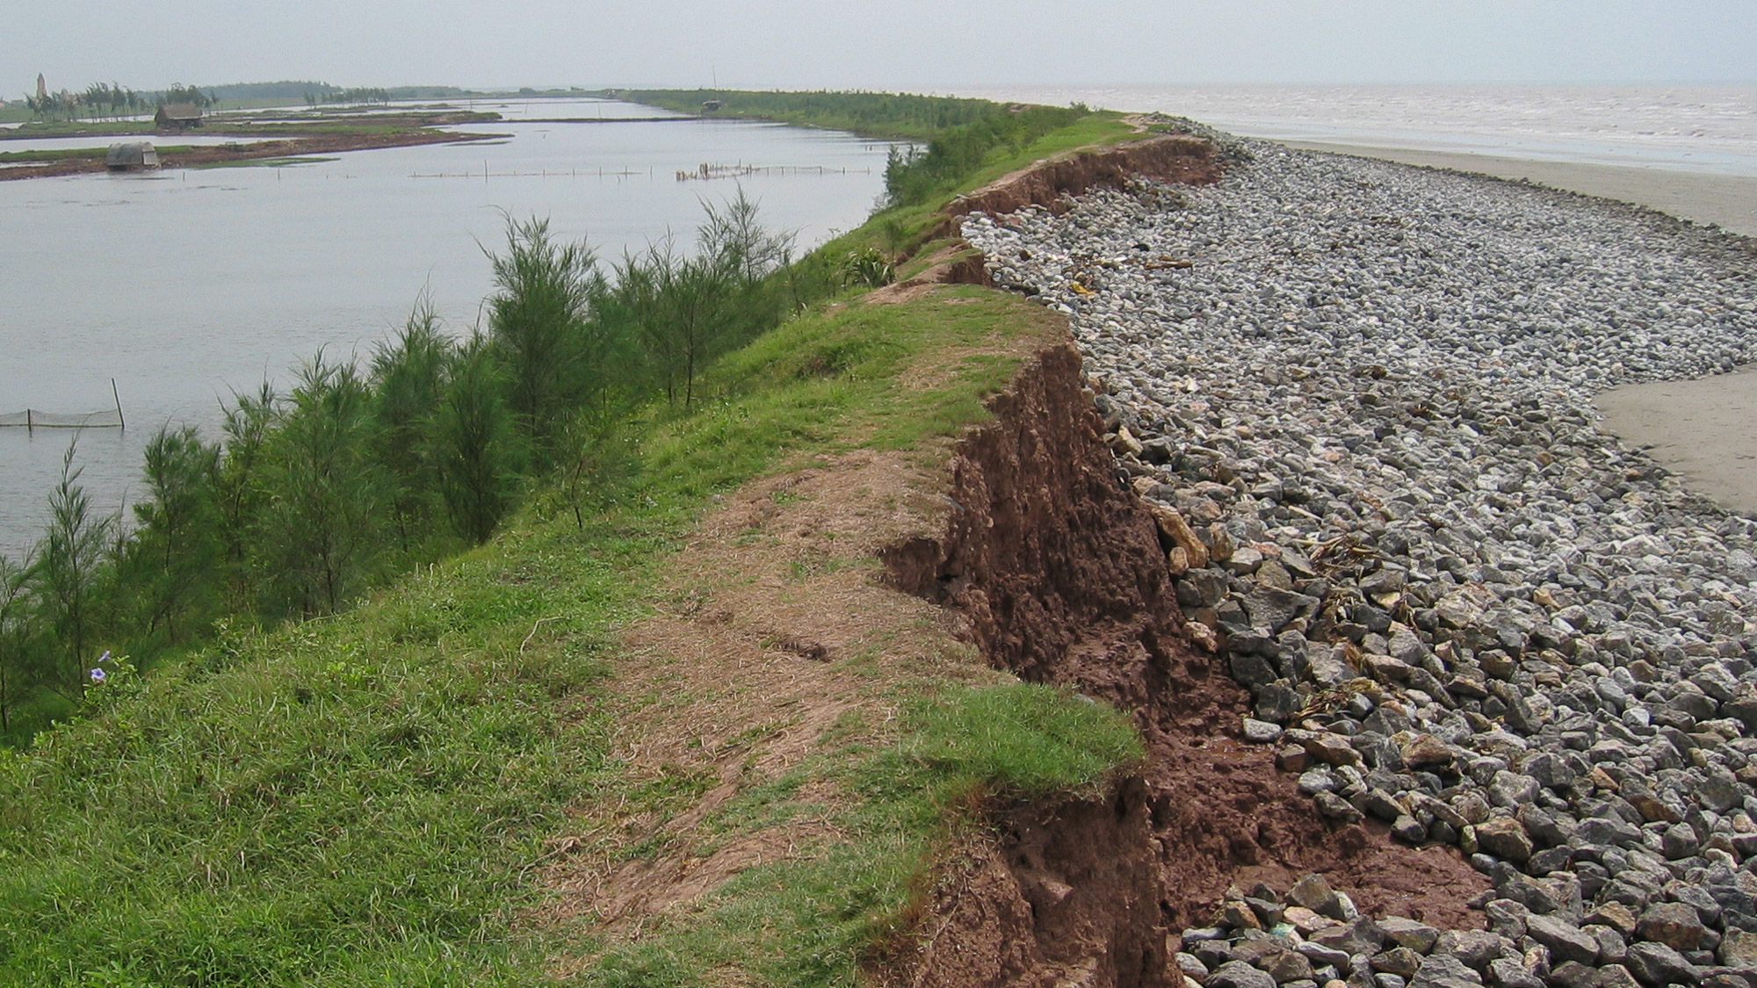
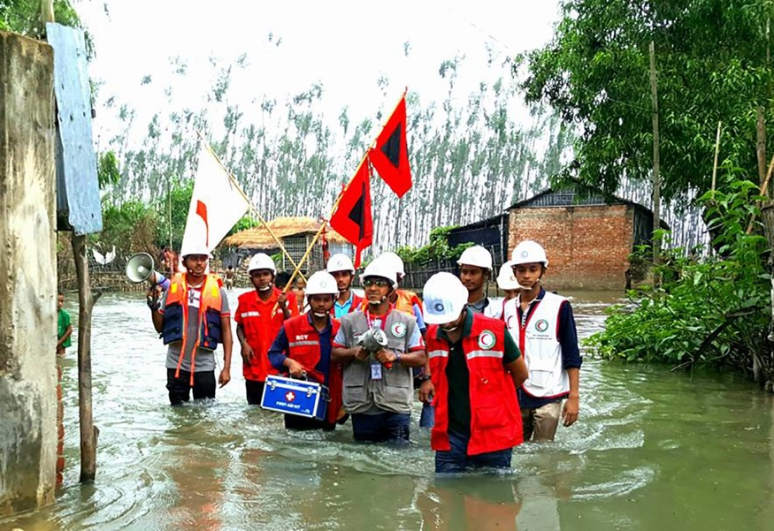
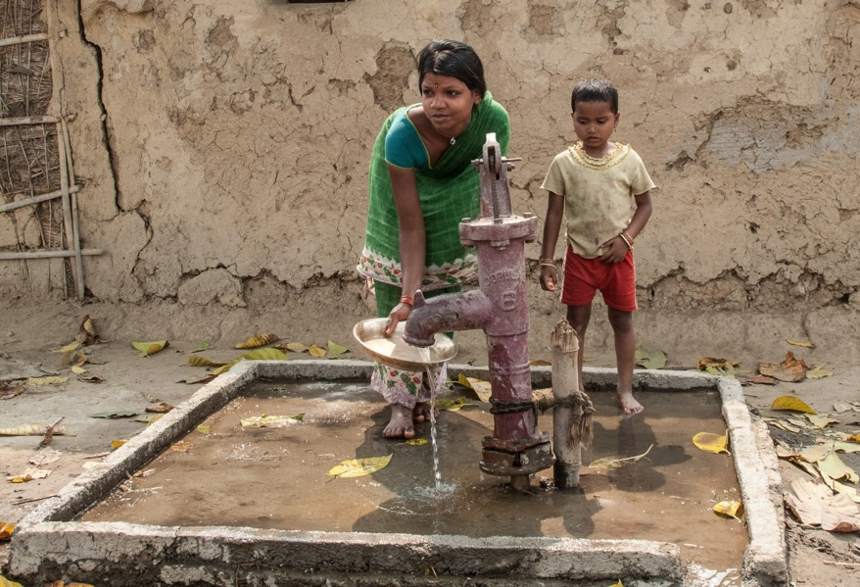
Sea level rise: coastal erosion, flooding and salt water intrusion
Coastal and low-lying areas will increasingly experience adverse impacts such as submergence, coastal flooding, and coastal erosion (IPCC, very high confidence)
Salt water intrusion threatens drinking water quality and jeopardizes soil fertility in low-lying coastal areas and small islands
Photo: IFRC
Photos: Danish Red Cross
Notes:
The risk of coastal erosion (damaging coastal protection walls etc.) and storm surge/flooding is also increasing due to the rising average sea levels, and this can be exacerbated by changing patterns of storms or extreme rainfall events. (IPCC 2014 SPM p 17 https://www.ipcc.ch/site/assets/uploads/2018/02/WGIIAR5-PartA_FINAL.pdf)
Climate is never the only factor that can increase risk of flooding. Floods can of course also be strongly affected by other factors, such as rapid and unplanned urbanization, population growth and poor natural resource management.
Salt water intrusion into rivers and ground water threatens drinking water quality and availability, jeopardizes irrigation/farming and soil fertility in coastal regions; Bangladesh is a particular case of high risk.
One World Bank study is available here: http://www.worldbank.org/en/news/feature/2015/02/17/salinity-intrusion-in-changing-climate-scenario-will-hit-coastal-bangladesh-hard

Slide 26
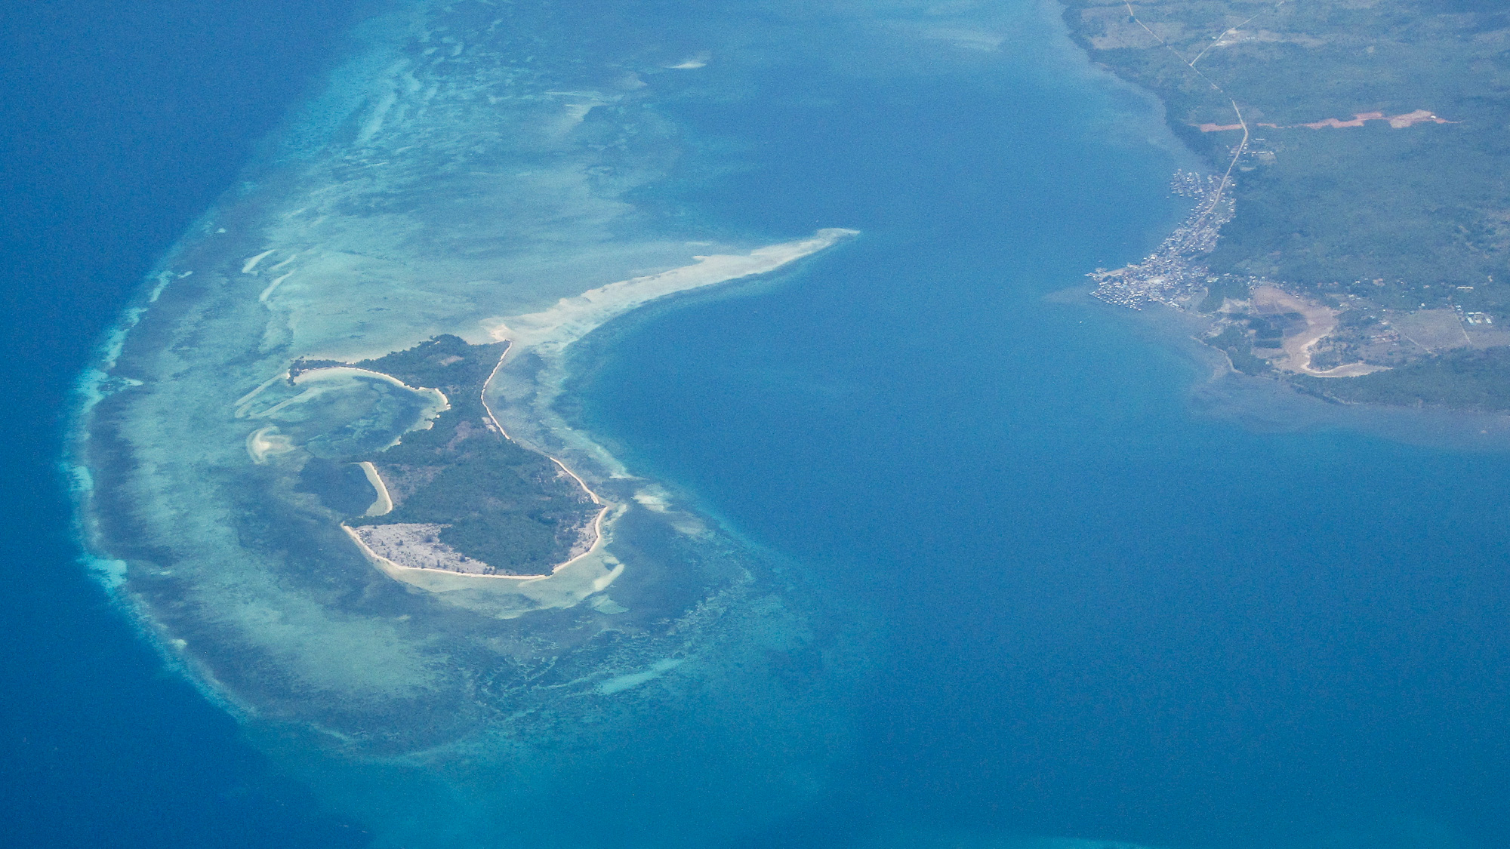
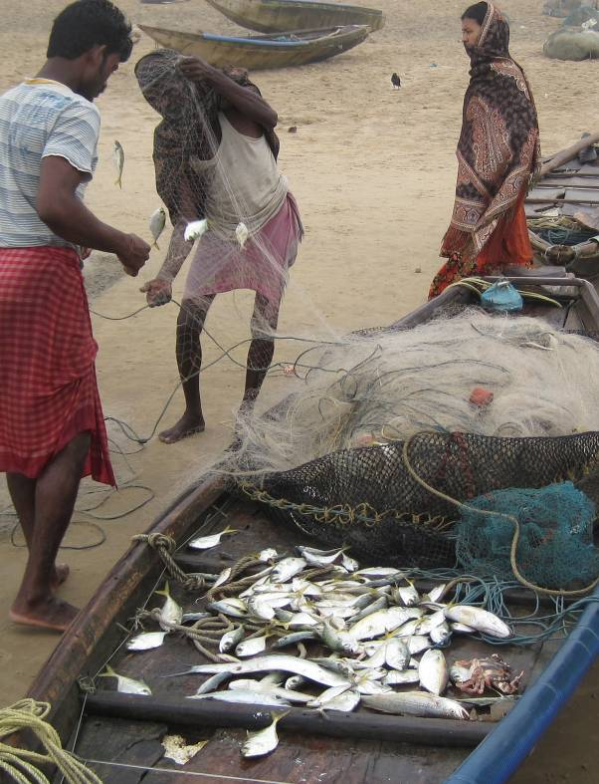
Oceanic changes – acidification, warming
Large scale degradation and/or loss of coastal and marine ecosystems
the oceans are becoming more acidic
sea temperatures are increasing
... and fish stocks decline, eroding livelihoods for millions of people
Ocean acidification and warmer waters damages coral reefs – reducing their coastal protection effects
Photos: Climate Centre
Notes:
The acidity of the ocean is increasing as a direct result of the increasing concentration of the amount of greenhouse gases (especially CO2) in the atmosphere.
The oceans absorb the CO2, which makes them more acidic. More acid water harms many ocean ecosystems such as coral reefs.
The degradation to coral reefs can be harmful for human habitations nearby, which used to use the coral reefs as protection from storms. Also, many costal populations depend on animals and plants living in these reefs for their livelihoods (fishing), and their food security is at risk if the reefs are destroyed.

Slide 27
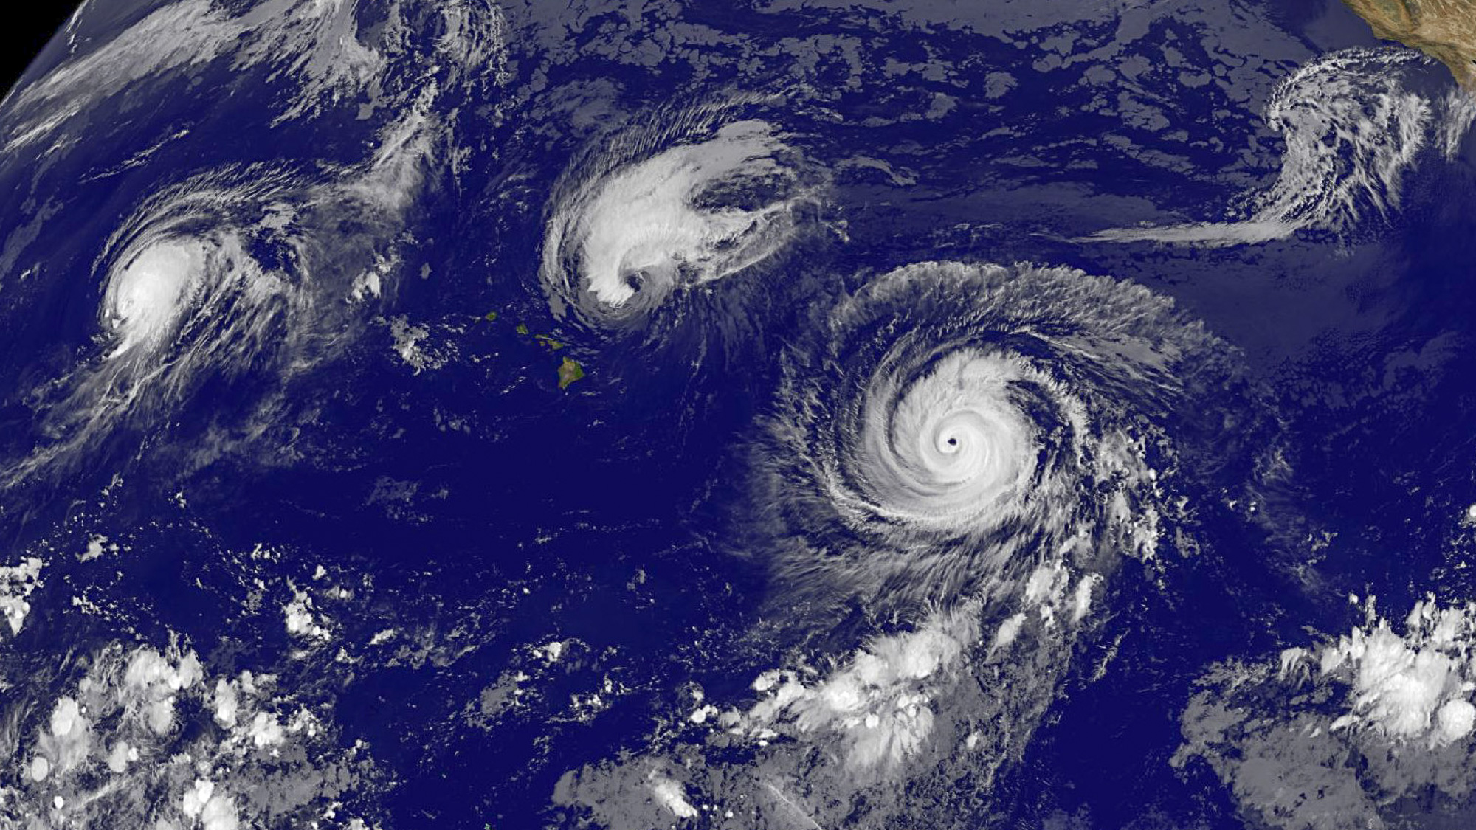
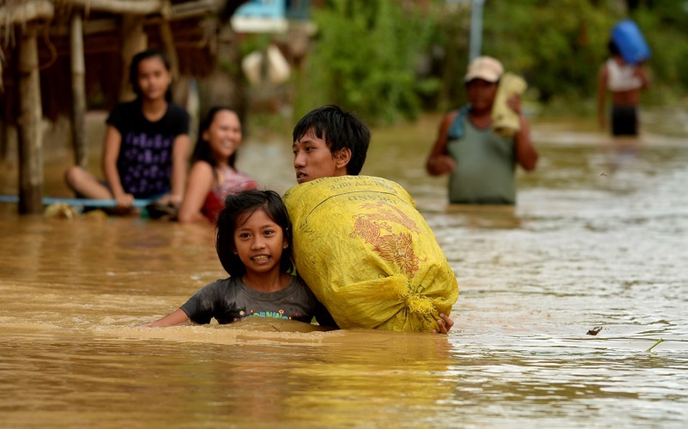
Cyclones – hurricanes/typhoons
Possibly an increase in the intensity of tropical cyclone activity (hurricanes/typhoons)
… coupled with higher storm surges due to sea level rise
→ economic/human losses are expected to increase
Photo: IFRC
Image: NASA/NOAA GOES Project
Notes:
Satellite image: 3 cyclones in the Pacific 2015 (source NASA/NOAA GOES Project)

Slide 28
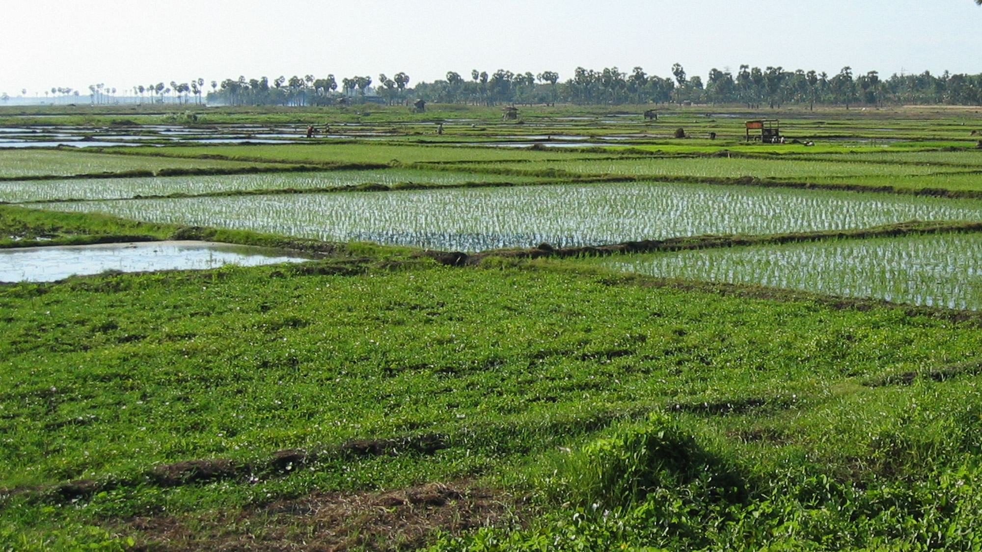
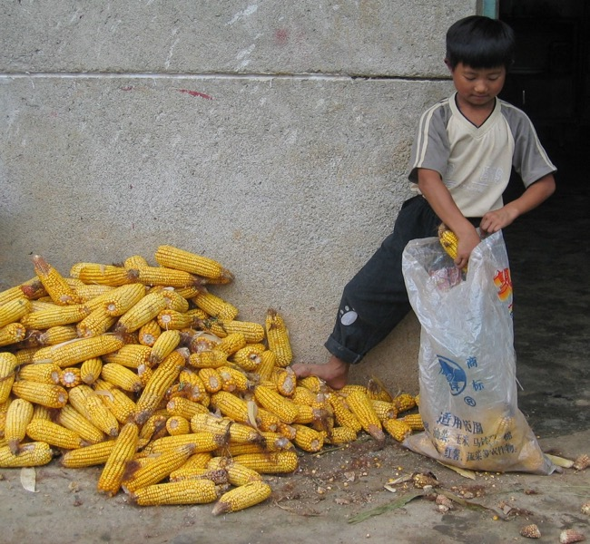
Food security challenges
Huge variability around the globe – and in agriculture and fisheries; projected impacts vary across crops and regions and adaptation scenarios.
Observed effects so far mostly on 'food availability'
Climate change has negatively affected wheat and maize yields for many regions (IPCC, medium confidence);
Some positive trends in some high latitude regions
Climate change could increase the risk of hunger and malnutrition by up to 20% by 2050 (WFP)
Photos: Danish Red Cross
Notes:
All aspects of food security are potentially affected by climate change, including food access, utilization, and price stability (IPCC, high confidence).
Quotes from IPCC (AR5, WG2):
Based on many studies covering a wide range of regions and crops, negative impacts of climate change on crop yields have been more common than positive impacts (high confidence). The smaller number of studies showing positive impacts relate mainly to high-latitude regions.
Climate change has negatively affected wheat and maize yields for many regions and globally (medium confidence). Observed impacts relate mainly to production aspects of food security rather than access or other components of food security
WFP notes that "With the vast majority of the world’s hungry exposed to climate shocks, eradicating hunger requires bold efforts to improve people’s ability to prepare, respond and recover. Failing this, it has been estimated that the risk of hunger and malnutrition could increase by up to 20 percent by 2050." (https://www1.wfp.org/climate-action).
According to the UN Food and Agriculture Organisation report "Impact of Climate on Food Security & Nutrition 2018":
Conflict and violence in several parts of the world as one of the main drivers of hunger and food insecurity, suggesting that efforts to fight hunger must go hand-in-hand with those to sustain peace. New evidence highlights that beside conflicts, climate variability and extremes are also a key force behind the recent rise in global hunger. They are also one of the leading causes of severe food crises.
See FAO report here: http://www.fao.org/state-of-food-security-nutrition/en/
World Food Programme

Slide 29
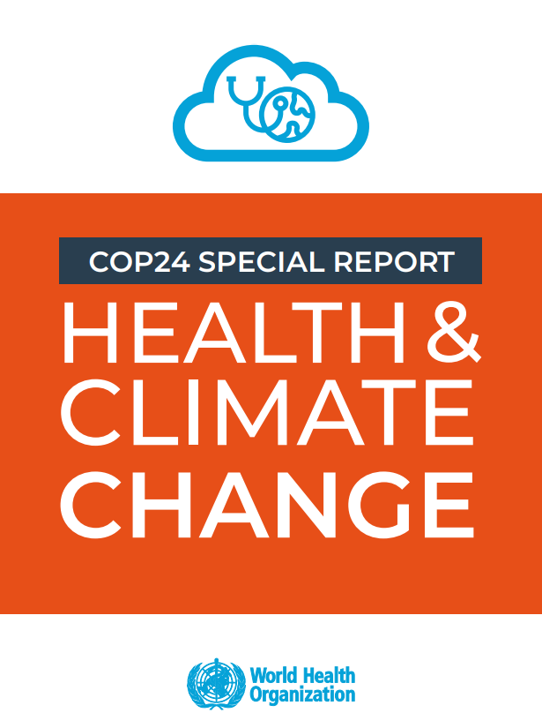
Health impacts everywhere
WHO (2018) states:
"A highly conservative estimate of 250 000 additional deaths each year due to climate change has been projected between 2030 and 2050; of these
38 000 will result from exposure of the elderly to heat
48 000 from diarrhoea
60 000 from malaria
95 000 from childhood undernutrition"
Notes:
Shifting weather patterns are changing the geographical range, seasonality and intensity of transmission of climate-sensitive diseases as greater warming will increase the range of certain vectors and diseases (including malaria, dengue, West Nile and Lyme disease) to previously unexposed areas with Europe and North America."
The WHO report (2018) states:
"A highly conservative estimate of 250 000 additional deaths each year due to climate change has been projected between 2030 and 2050; of these, 38 000 will result from exposure of the elderly to heat, 48 000 from diarrhoea, 60 000 from malaria and 95 000 from childhood undernutrition. These estimates were calculated within an optimistic scenario in terms of future socioeconomic development and adaptation; furthermore, they cover only four direct effects of climate change on health, while there are many more direct and indirect effects and more complex causal pathways that have not been quantified. Thus, the health of hundreds of millions more people could be affected by climate change"
https://apps.who.int/iris/bitstream/handle/10665/276405/9789241514972-eng.pdf?ua=1

Slide 30

How much can we blame climate change?

Slide 31
Weather or climate?
Weather: Short Timescales
“hours, days”
Climate: Long Timescales
“average over the past 30 years”
Will I need an umbrella today?
Is it raining? What is the weather?
I’m going to Nairobi in May – is that normally the rainy season there? What is the climate?
Notes:
Before we go on let us clarify the difference between weather and climate:
(ASK the participants to describe how they perceive the difference before you reveal the answers on the slide)
Then wrap up:
“Climate is what you expect, weather is what you get’
climate is what usually happens in a location (i.e.: it usually rains in May),
weather is what happens on any given day (i.e.: it is not raining on May 10).
Here, we are talking about changes to the climate system, which means changes to what is usual for a location.
Therefore, if the climate of a location is expected to get warmer, it means that location will be warmer on average, but we can’t predict how the weather will turn out on any given day.
An easy way to remember the difference: “Climate is what you expect, weather is what you get.”

Slide 32

Attribution – is climate change involved?
Climate scientists used to say “we can’t attribute any single event to global warming”
The science is advancing fast: it is now often possible to estimate the extent to which human-induced climate change has influenced either the magnitude or the probability of occurrence of specific types of events
Notes:
For National Societies it will be very relevant to have access to the outcomes of such an attribution study during the event, because the receptiveness to discuss what is needed to avoid this from happening again (with respect to recovery) is high. Also further discussions with policy makers can have more impact when the attribution study shows that such an event is for instance three times more likely. For general awareness and communication it is also very good to show how the NS is concerned about more frequent impacts happening now because of climate change.
National Academies of Sciences, Engineering, and Medicine 2016. Attribution of
Extreme Weather Events in the Context of Climate Change. Washington, DC: The
National Academies Press. https://doi.org/10.17226/21852.

Slide 33
Attribution – is climate change involved?
Scientific attribution of climate change to specific events is yet most certain for:
Extreme heat and cold
followed by drought and extreme rainfall
.. and still most difficult for:
Tornadoes
followed by wildfires and cyclones
Notes:
Good to explain here that it is not yet possible for all hazards do the analysis of attributions. Extremes in temperature and precipitation can give best attribution outcomes (meaning most certainty whether the magnitude or frequency of the particular disaster is linked to climate change or not.)
National Academies of Sciences, Engineering, and Medicine 2016. Attribution of
Extreme Weather Events in the Context of Climate Change. Washington, DC: The
National Academies Press. https://doi.org/10.17226/21852.

Slide 34


Attribution example – hurricane Harvey, 2017
August 25–30, unprecedented rainfall totals recorded, e.g. 1318 mm near Houston, Texas:
flooding impacted more than 100000 homes
>120 000 rescues
>80 deaths
Among most costly natural disasters in US history
Image: NASA Earth Observatory
Global warming has
increased the intensity of the three-day rainfall extremes on the Gulf Coast
and made Harvey's 3-day rainfall 3 times more likely
Sea level rise (from climate change) and urban development is not considered in this analysis, but also contributed
Notes:
Attribution analysis showed:
The three-day rainfall sums that were responsible for most of the flooding were extremely rare, with a return time for station observations of more than 9000 yr (97.5% CI) in the current climate, taking the trend into account. This would have caused flooding in any city.
Strong evidence that global warming has increased the intensity of the three-day rainfall extremes on the Gulf Coast, or equivalently, has increased the probability of a given rainfall event. Based on extrapolations from observed for extreme events, we find that the
intensity of rainfall increased by 15% (8%–19%) and
the probability of this much rain or more by a factor of three (1.5–5).
This increase in rainfall intensity contributed to the flooding observed in Houston and surrounding areas.
See full analysis here: https://www.worldweatherattribution.org/hurricane-harvey-august-2017/

Slide 35


Attribution example – Chennai, India, 2015 floods example:
Heaviest one-day rainfall in more than a century: 494mm
probability of occurrence of in the current climate is once every 600 to 2500 years = very rare
Has the risk of an extreme rainfall event like 2015 Chennai case increased?
Climate models showed no increase in the probability of extreme one-day rainfall in the region due to human-caused emissions = no climate change effect detected
However, satellite images from 1982 and 2012 shows explosive population growth, land use changes, large-scale settlements in low lying areas and building on former drainage channels
This strongly contributed to the severity of flooding
Source: India Times
Notes:
Attribution study showed:
The heaviest one-day rainfall in the region in more than a century: 494mm
Left >3 million people without basic services, collapsed roads and bridges, and halted air and train travel in and out of the city, stranding hundreds of passengers.
Many newspapers and political figures speculated about the role of climate change immediately after the event. But a scientific answer was not available.
The probability of occurrence of this event in the current climate is at least 1 in 600 years, but it could be up to a 1 in 2500 year event – very rare. This would have overwhelmed flood protection measures in any city.
Reasoning for no anthropogenic climate change effect might be that greenhouse gases and aerosols have opposing effects (GHG increases rainfall, aerosols decrease).
See full analysis here: https://www.worldweatherattribution.org/chennai-floods-december-2015/

Slide 36
















Attribution – 2015 examples: global and North America
Source: https://theconversation.com
If you want updates on attribution case studies – connect with:
attribution@climatecentre.org
www.worldweatherattribution.org
Notes:
OPTIONAL SLIDES – for regional events:
As facilitator, you may select which of the following regional examples are appropriate for your audience – and "unhide" the ones you need (NOTE: to unhide, 'right-click' on the slide in the overview to the left in the powerpoint layout, and click 'hide').
See more on the source: https://theconversation.com/infographic-climate-change-and-2015s-year-of-wild-weather-70485
The background reports from 2011 and onward are available here:
"Explaining extreme events of 2017 from a climate perspective": https://www.ametsoc.org/ams/index.cfm/publications/bulletin-of-the-american-meteorological-society-bams/explaining-extreme-events-from-a-climate-perspective/

Slide 37










Attribution – 2015 examples: Asia - Pacific
Notes:
OPTIONAL SLIDES – for regional events:
As facilitator, you may select which of the following regional examples are appropriate for your audience – and "unhide" the ones you need (NOTE: to unhide, 'right-click' on the slide in the overview to the left in the powerpoint layout, and click 'hide').
See more on the source: https://theconversation.com/infographic-climate-change-and-2015s-year-of-wild-weather-70485
The background reports from 2011 and onward are available here:
"Explaining extreme events of 2017 from a climate perspective": https://www.ametsoc.org/ams/index.cfm/publications/bulletin-of-the-american-meteorological-society-bams/explaining-extreme-events-from-a-climate-perspective/

Slide 38






Attribution – 2015 examples: Africa and Europe
Notes:
OPTIONAL SLIDES – for regional events:
As facilitator, you may select which of the following regional examples are appropriate for your audience – and "unhide" the ones you need (NOTE: to unhide, 'right-click' on the slide in the overview to the left in the powerpoint layout, and click 'hide').
See more on the source: https://theconversation.com/infographic-climate-change-and-2015s-year-of-wild-weather-70485
The background reports from 2011 and onward are available here:
"Explaining extreme events of 2017 from a climate perspective": https://www.ametsoc.org/ams/index.cfm/publications/bulletin-of-the-american-meteorological-society-bams/explaining-extreme-events-from-a-climate-perspective/

Slide 39
A 1.5ºC or a 2ºC world
– what's the difference?

Slide 40


The Paris Agreement (2015) – a historic moment
But what's the difference of 0.5˚ C?
Limit long-term global warming to "below 2˚C before 2100"
“Pursuing efforts” towards to limit it to 1.5˚C
However, current pledges under the Paris Agreement are not enough to keep mean global warming to 1.5˚C; the limit may be passed around 2040
Notes:
The Paris Agreement outcomes
The measures in the agreement included:
To peak greenhouse gas emissions as soon as possible and achieve a balance between sources and sinks of greenhouse gases in the second half of this century
To keep global temperature increase "well below" 2C and to pursue efforts to limit it to 1.5C
To review progress every five years
$100 billion a year in climate finance for developing countries by 2020, with a commitment to further finance in the future.
But how much difference does 0.5 degrees mean?
IPCC investigated that and 2018 released the 1-5C report: http://www.ipcc.ch/report/sr15/

Slide 41

Main differences – headlines
The risks posed by global warming of 1.5ºC are greater than for present day conditions, but lower than at 2ºC
In a 1.5ºC world there will be an increase in extremes including:
hot extremes in all inhabited regions (high confidence)
heavy rainfall in several regions (medium confidence)
drought and rain/snowfall deficits (medium confidence)
Notes:
In addition to the IPPC 1.5 report (link on previous slide), the "Carbon Brief" interactive website is detailing the differences in climate impacts between 1.5°C and 2°C, based on 70 peer-reviewed studies.
https://interactive.carbonbrief.org/impacts-climate-change-one-point-five-degrees-two-degrees/?utm_content=buffer621d0&utm_medium=social&utm_source=twitter.com&utm_campaign=buffer#

Slide 42


Slide 43








Selected climate change hot spots – IPCC 1.5ºC Report
Region | Global warming <1.5°C | 1.5 - 2°C | 2 - 3°C
Tropics | Heat waves up to 2 months (high confidence) | Heat waves up to 3 months (high confidence) | Harsh temperatures and heat waves directly affect health, mortality and productivity very likely
 | 3% loss in maize crop yield | 7% loss in maize crop yield | Substantial crop losses very likely
Southeast Asia | Risks for increased flooding due to sea level rise | Higher risks for increased flooding due to sea level rise | Substantial increases in risks related to flooding from sea level rise
 | Increases in heavy rainfall events | Stronger increases in heavy rainfall events | Substantial increase in heavy rainfall events and high flow events
 | Significant risks of crop yield reductions avoided | 33% decline in per capita crop production (medium confidence) | Substantial reductions in crop yields
West Africa & Sahel | Reduced maize & sorghum production; maize possibly by reduced 40% | Negative impacts on maize and sorghum producrion likely larger than at 1.5°C | Major regional food insecurities (medium confidence)
 | Increased risks for under-nutrition | Higher risks for under-nutrition | High risk for under-nutrition
Photo: IFRC
Small Island Development States (SDIS) | Compared to 2°C, land of 60,000 less people exposed by 2150; risks for coastal flooding reduced by 20–80% | Tens of thousands of people displaced owing to Inundation; high risks for coastal flooding | Substantial impacts coastal flooding, freshwater stress, heat stress & loss of coral reefs
Notes:
Examples of the difference in impacts between 1.5, 2 and 3 degrees average global warming.
Taken from IPCC 1.5ºC Report, Table 3.6 (Ch. 3, page 261) – full table available in 'Recommended Reading' for this CTK module
All photos (except IFRC): Climate Centre

Slide 44

If we are serious about limiting warming to 1.5ºC:
  we need to halve CO₂ emissions before 2030 and go to net zero carbon by 2050
  it will require an unprecedented scale of change including investments in energy production, industrial processes, the building industry and farming
  it requires some Carbon Dioxide Removal (CDR*) between now and 2100. The faster we take emissions to zero, the less CDR we will need to do. CDR is not currently feasible at a large scale
* CDR = remove CO₂ from the atmosphere, for instance by planting trees – the most effective method so far – or chemically capturing CO₂ (various methods) and store deep in the ground, for instance old oil fields.
Photo: Climate Centre
Notes:
The report shows many different possible pathways for limiting warming to 1.5. Some of these pathways also include overshoot – the possibility to temporarily exceed 1.5 degrees and then come back down. However, that scenario is associated with potential tipping points and negative impacts that cannot be reversed such as reductions in biodiversity, loss of artic sea ice, and sea level rise.
Some important points for mitigation (chap 2 p29):
choices in one sector affect the efforts that are required from others
The extra emissions reductions that make up the different between 1.5 and 2 degree pathways come primarily from transport and industry sectors
Most 1.5°C-consistent pathways require more stringent emissions reductions by 2030 than implied by the current NDCs

Slide 45

To geo-engineer or not to geo-engineer?
Techniques for CDR (CO₂ storage) to the left in the picture have low risks, but are as of yet too expensive to implement large scale.
Altering Earth’s climate by manipulating the oceans and atmosphere (right and upper part of picture) are still high-risk experiments if implemented now.
Every person on our planet is potentially a test subject
UNEP 2009 – adapted from Lenton & Vaughan 2009
Notes:
With the climate change risk rapidly increasing – and the slow progress in reaching international agreements on how to limit the warming and keep temperatures within a ”manageable” range – some scientists and lobbyists are considering if there is a ”quick fix” solution to halt further warming.
This intentional manipulation of the global climate is called ”Geoengineering” and has several aspects.
This picture summarises many of the ideas:
Some of the techniques include removing greenhouse gasses (GHG) from the atmosphere and find long-term storage for them (mostly for CO2).
Other more extreme ideas include dispersing sulphur particles into the atmosphere to mimic the effects of dust from volcanoes, which is known to cool the earth for a while because the dust blocks some of the sun’s radiation from reaching the earth. Other ideas include to seed the oceans with algae fertilisers so the the population grows and absorb CO2 in the process, or place a huge mirror/umbrella between the sun and the Earth.
These extreme ideas are already being researched and discussed. Governance of such initiatives is highly contentious issue – who makes the decisions to alter and what will the local climate impacts be when we do. This is a risky experiment in which every person on our planet is potentially a test subject. Vulnerable populations are not likely to be at the table in discussions and it is unclear how to deal with potentially negative side effects of these methods if they become implemented.

Slide 46


Geo-engineering – a humanitarian concern
Will vulnerable people worldwide have a voice in geoengineering decisions?
Will there be extra funding for humanitarian work in a geoengineered future?
Photo: Climate Centre
Notes:
For humanitarians the prospects of geo-engineering raises two important questions:
Will vulnerable people worldwide have a voice in geo-engineering decisions?
Will there be extra funding for humanitarian work in a geo-engineered future?
In addition, if these technological fixes should be implemented, but suddenly gets damaged or discontinued, the globe will rapidly heat up – so it is definitely not a “sustainable solution” even for those of us who may have temporary benefits from the geo-engineering. This is called a possible ‘termination shock’. We proved the future generations to come with a necessary need to continue the manipulation of the earths atmosphere.
The only sustainable element included in the graph above (previous slide) is the afforestation/reforestation, modified agriculture practices and urban surface albedo (elements normally not considered geoengineering) – which is already, along with forest conservation and better land management, a key aspect of existing plans for helping minimise GHG concentrations in the atmosphere.
The Red Cross Red Crescent must be aware of these emerging challenges to vulnerable people and the humanitarian sector – and consider this topic for Humanitarian Diplomacy
Read more in this article http://geoengineeringourclimate.files.wordpress.com/2013/08/suarez-et-al-2013-ge-and-the-humanitarian-challenge-click-for-download.pdf

Slide 47




Four key areas of action
1. It is urgent for all countries to raise climate ambition to get closer to the goals of the Paris Agreement
2. Scale up action and investment in climate adaptation solutions that address rising humanitarian needs and bring impact for the most vulnerable
Photo: IFRC
3. Humanitarian actors need to apply a climate lens across their work and adapt their programming accordingly
Photo: Climate Centre
4. Local actors are key to delivering on climate adaptation
Photo: IFRC
Notes:
Wrapping up:
1. It is urgent for all countries to raise climate ambition to get closer to the goals of the Paris Agreement
Current NDCs need to be enhanced
Getting to 1.5 degrees is not impossible
Develop NDCs in an inclusive way
2. Scale up action and investment in climate adaptation solutions that address rising humanitarian needs and bring impact for the most vulnerable
Climate-smart disaster risk reduction
Prevention and anticipation (including early warning, early action; forecast-based financing)
Integrated risk management approaches, in particular, in domestic law and policy
3. Humanitarian actors need to apply a climate lens across their work and adapt their programming accordingly
Extreme weather will increase (e.g. heatwaves) and storm surges more powerful
The most vulnerable will become more vulnerable
To be effective in our humanitarian mandate, we have to consider to a changing climate
Integrate changing climate risks across key sectors
4. Local actors are key to delivering on climate adaptation
Increase investment in local actors
Support and accompany vulnerable communities to address the climate risks they face

